Slide 1


FPT SOFTWARE
Machine Learning Fundamentals
10/02/18

Slide 2
Supervised Learning
Lecture 2: Supervised Learning
Outline:
Inductive Learning
Classification, Regression
Decision Trees
Bayesian Learning
Neural Networks
Model Ensembles
Learning Theory
Support Vector Machine
Exercise

Slide 3
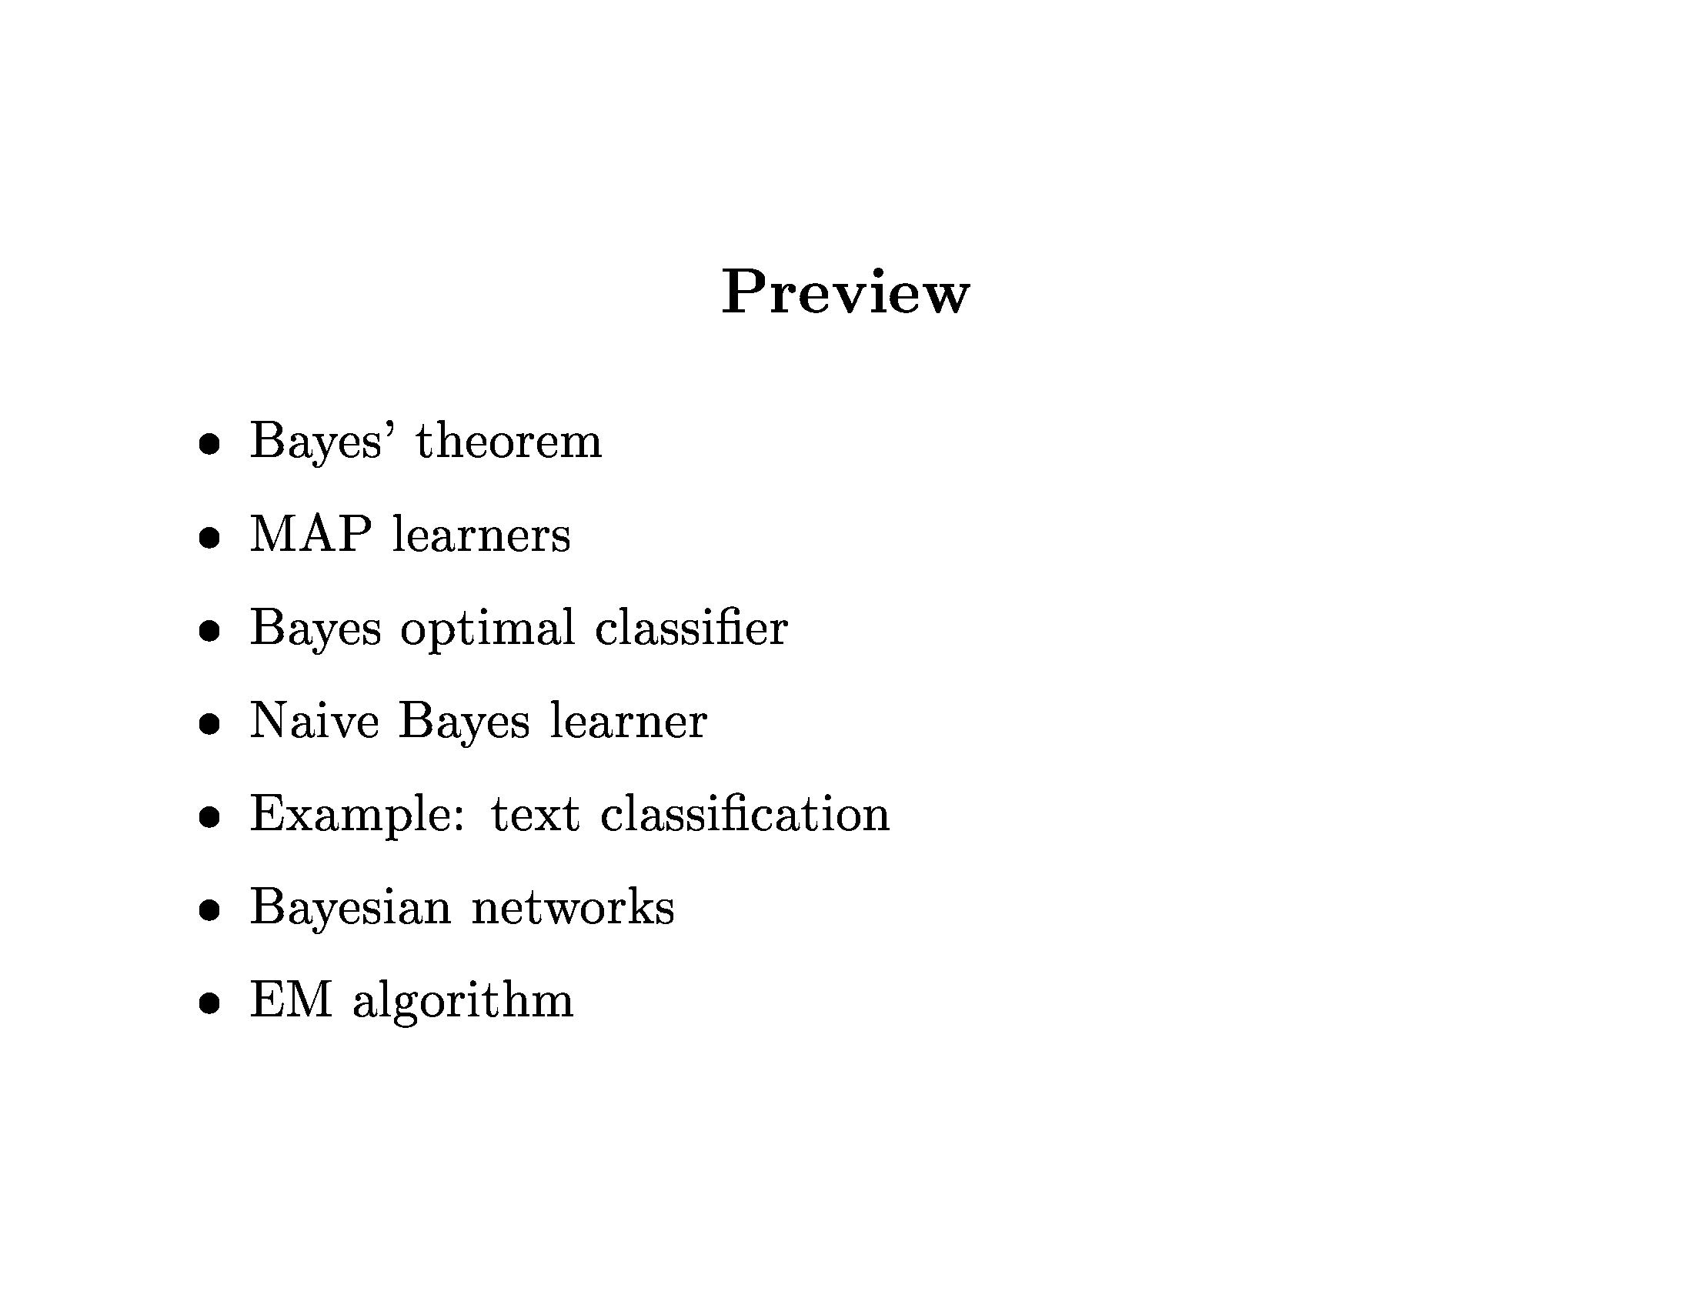
Bayesian Learning

Slide 4
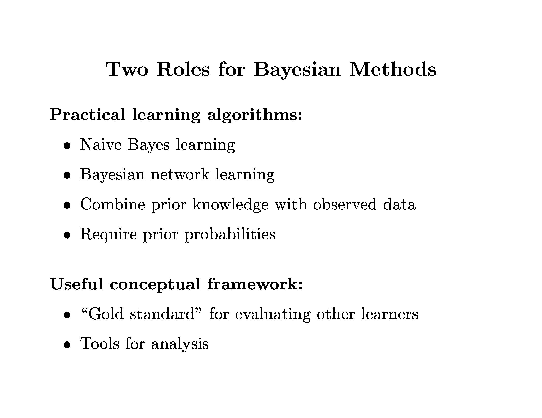
Bayesian Learning

Slide 5
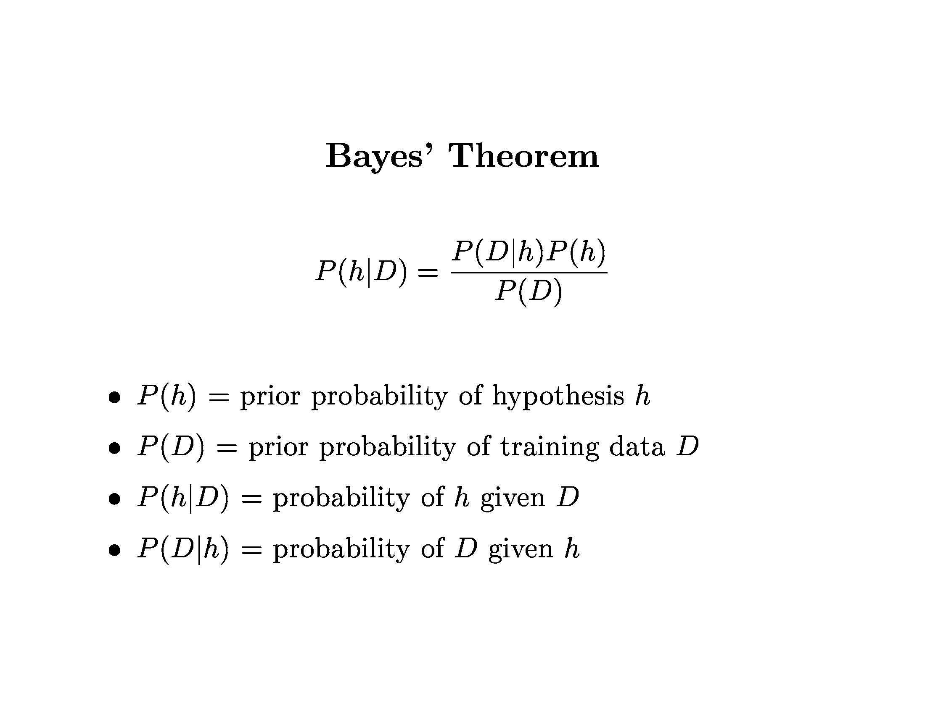
Bayesian Learning

Slide 6
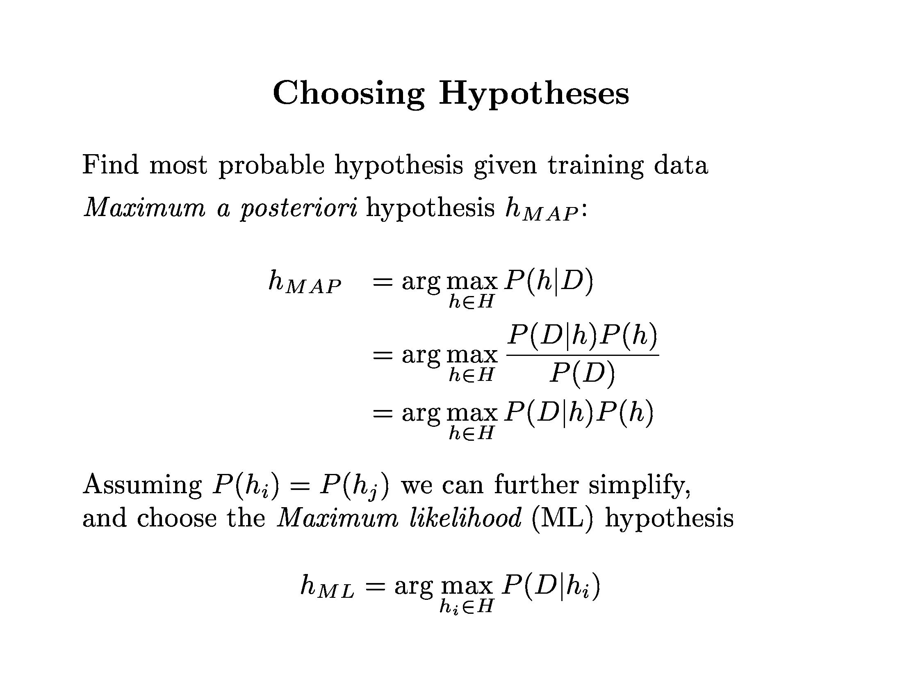
Bayesian Learning

Slide 7
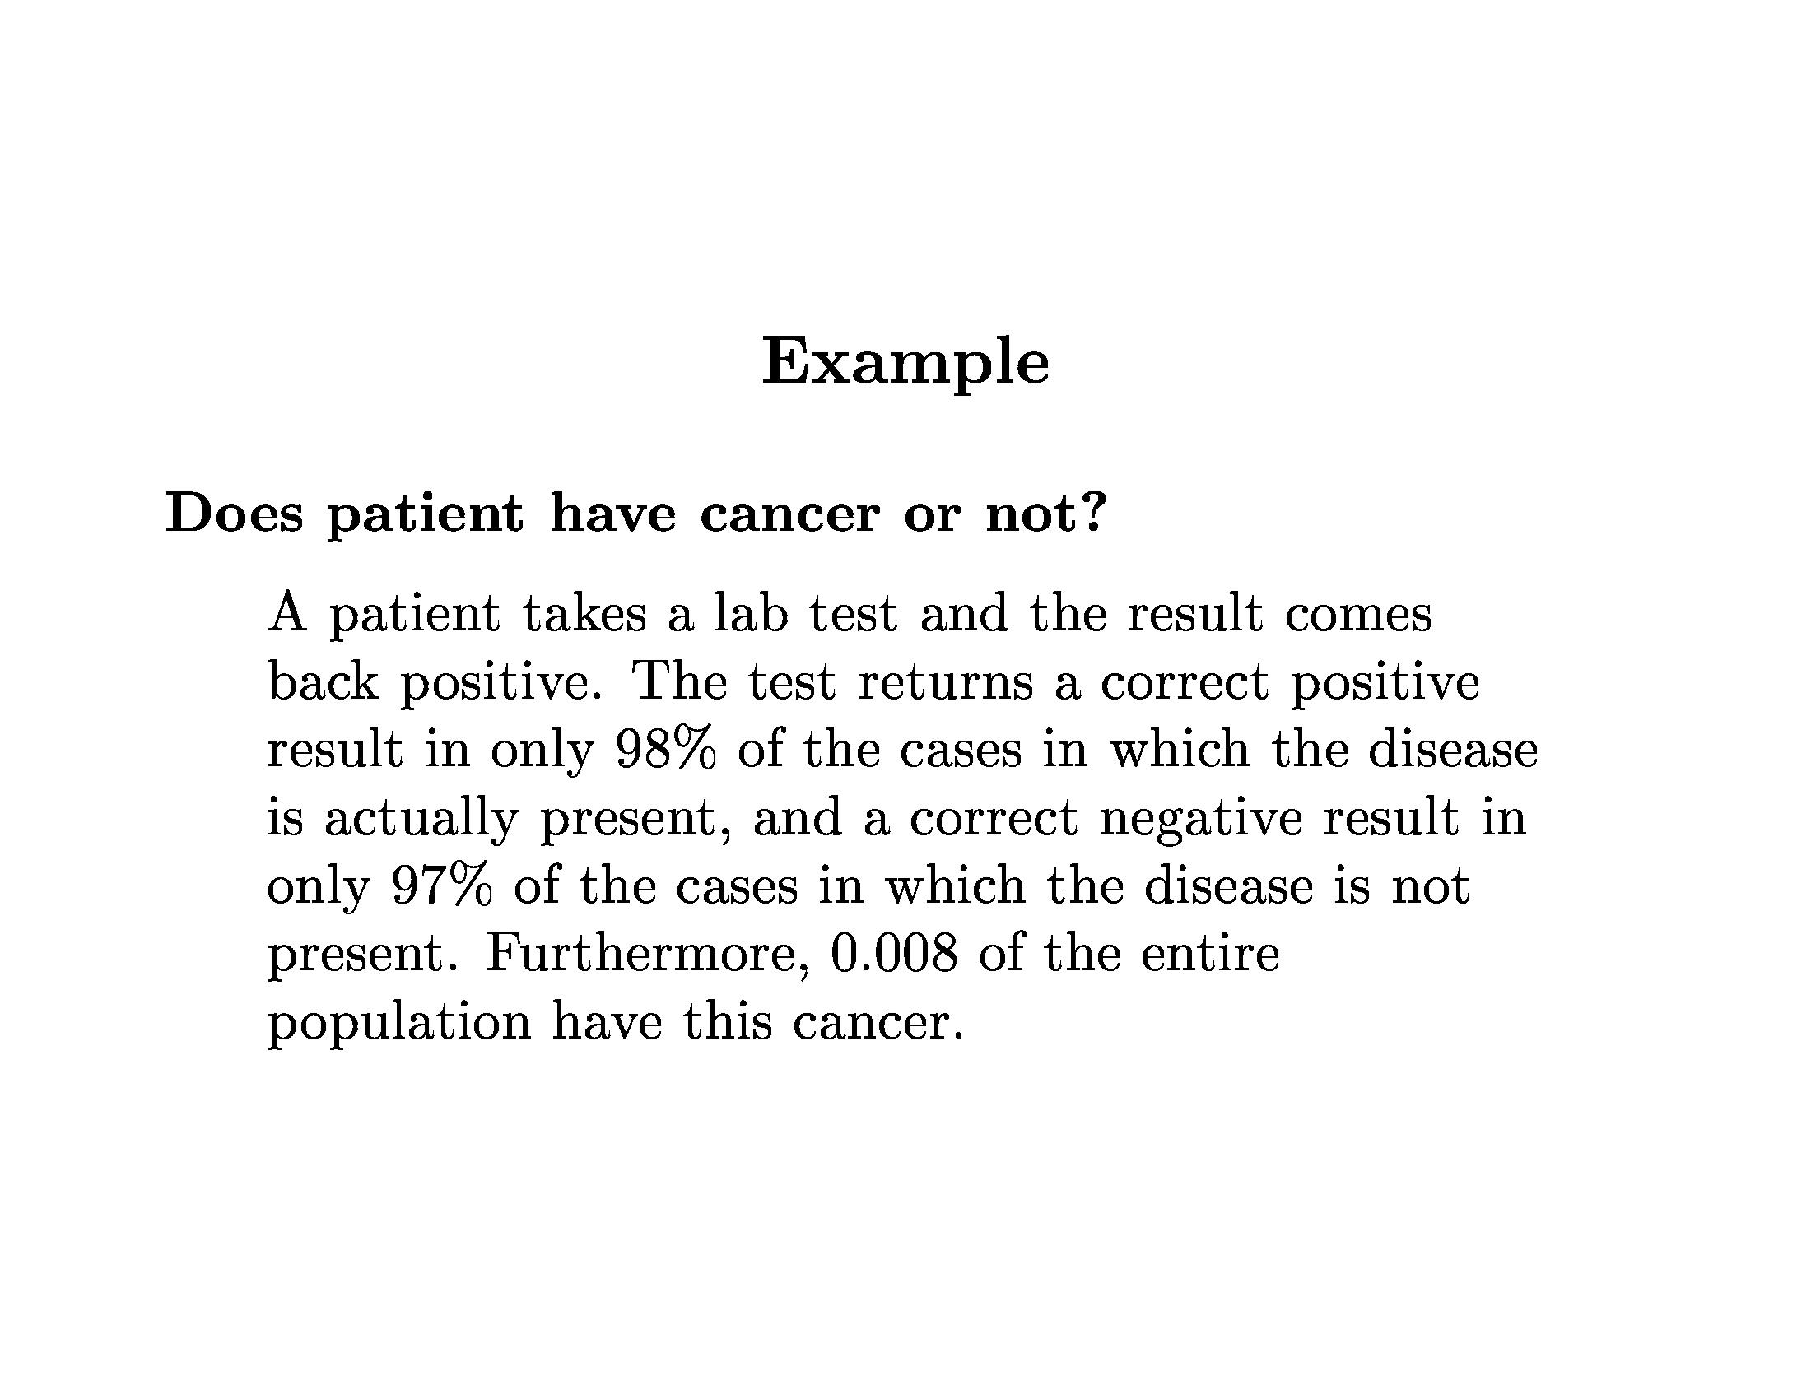
Bayesian Learning

Slide 8
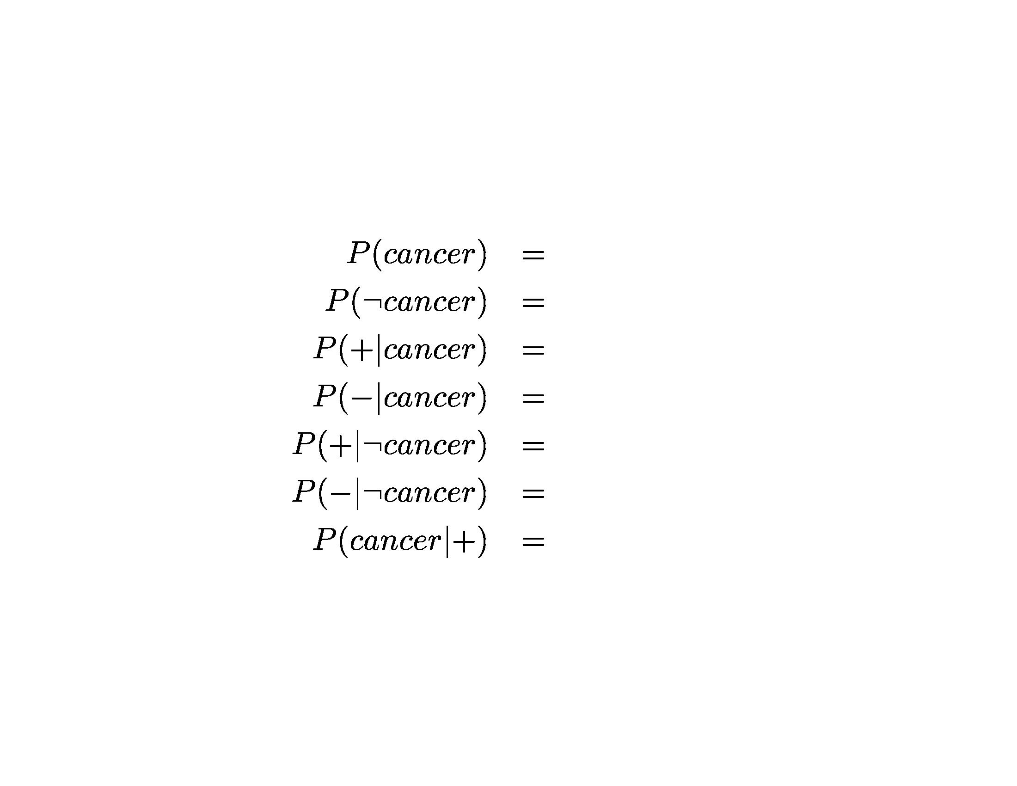
Bayesian Learning

Slide 9
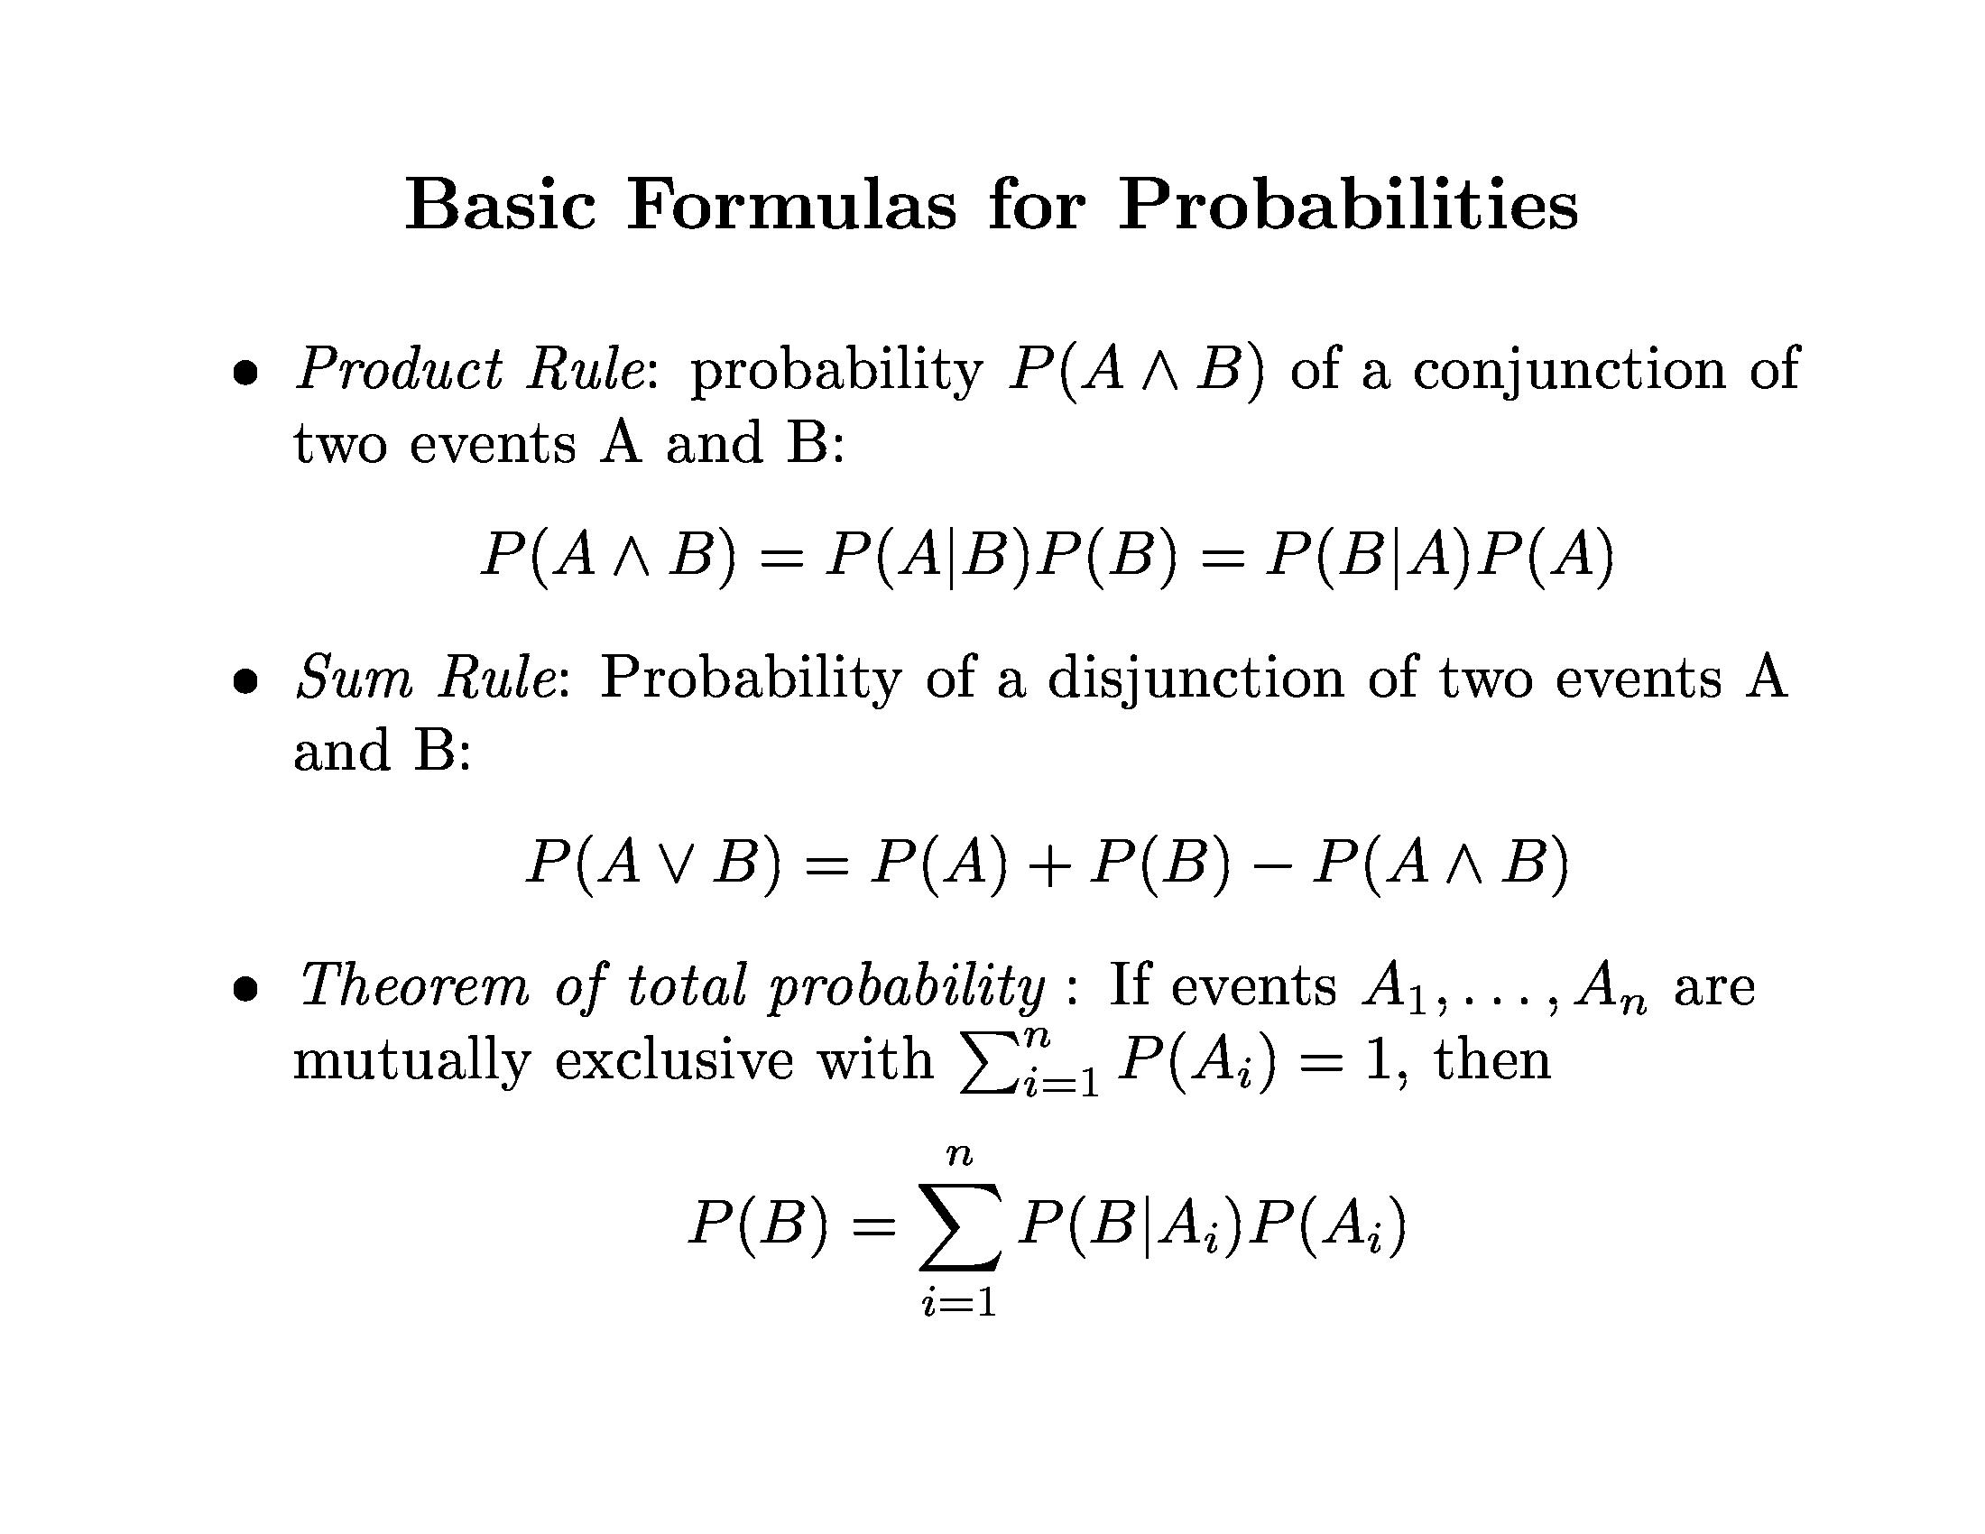
Bayesian Learning

Slide 10
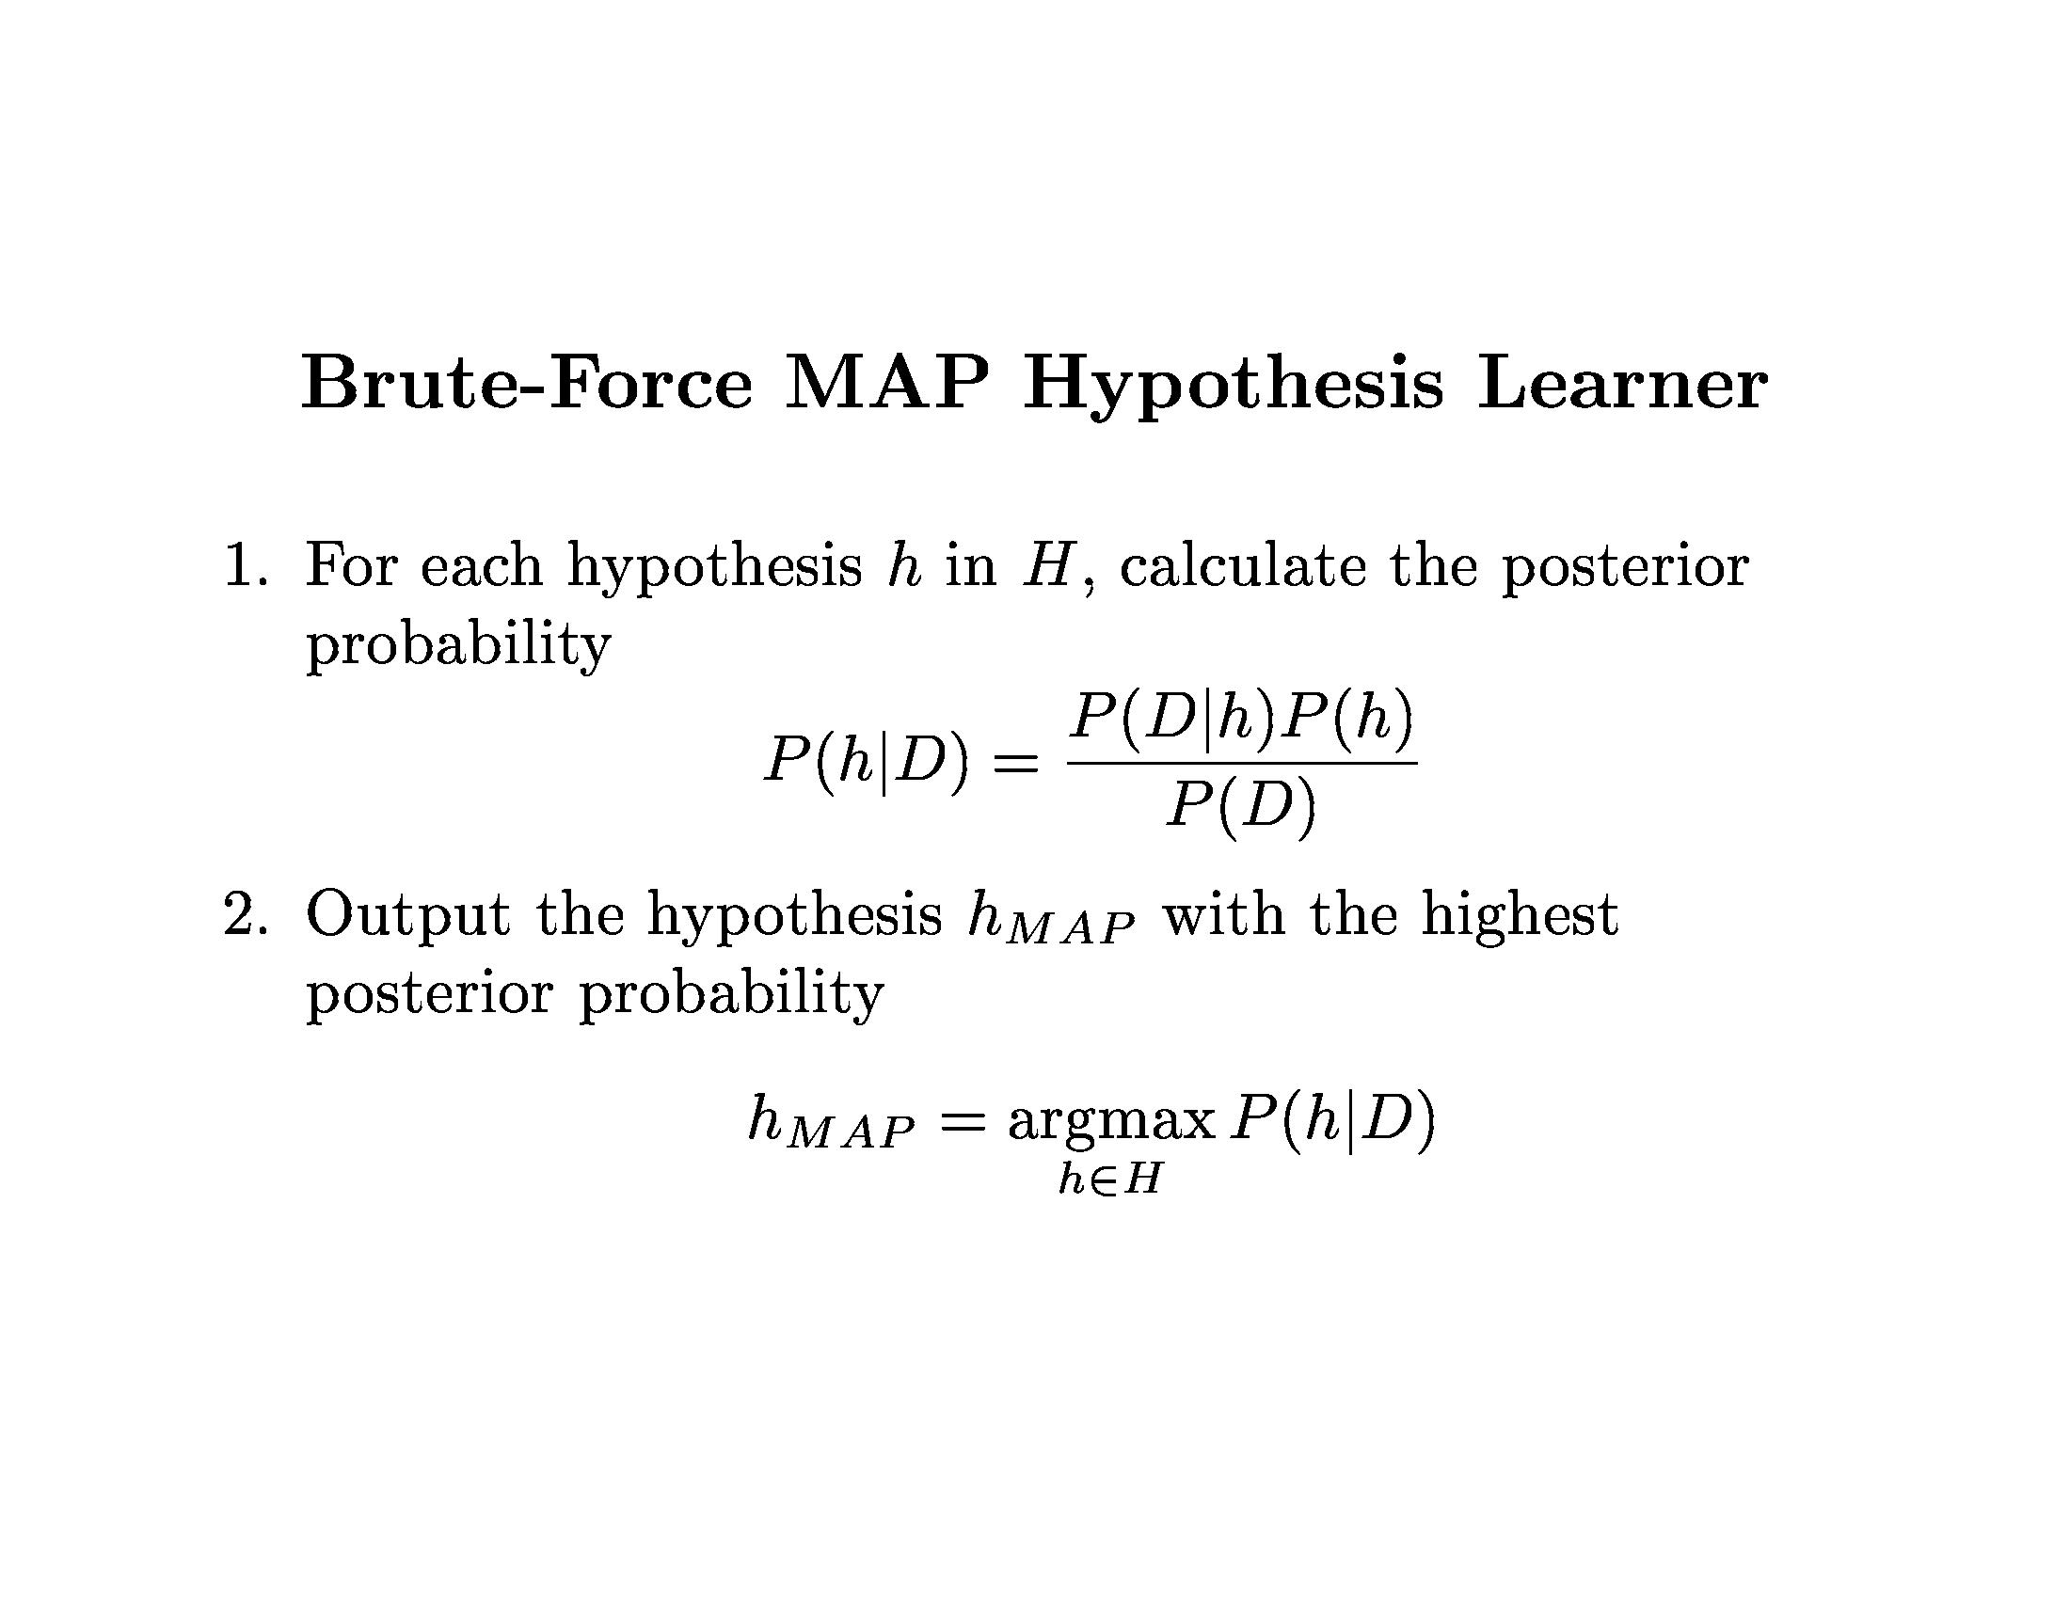
Bayesian Learning

Slide 11
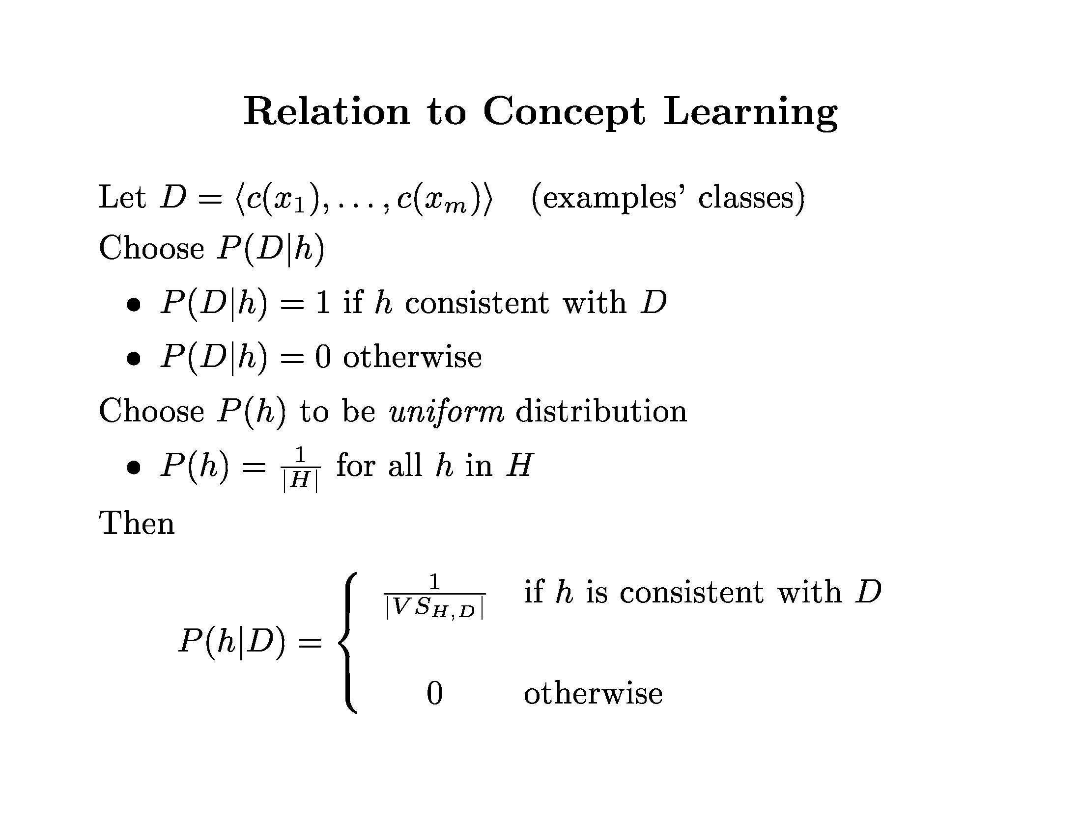
Bayesian Learning

Slide 12
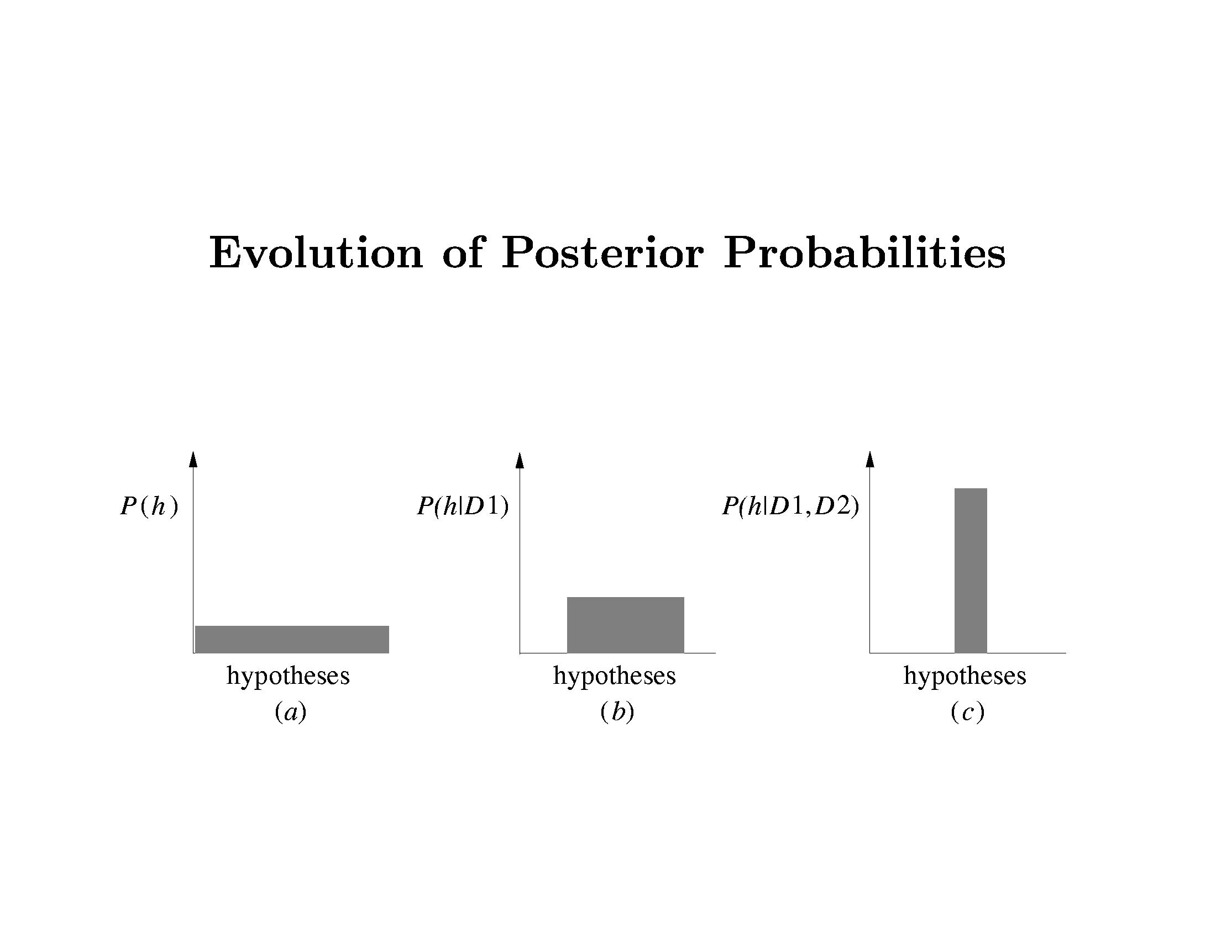
Bayesian Learning

Slide 13
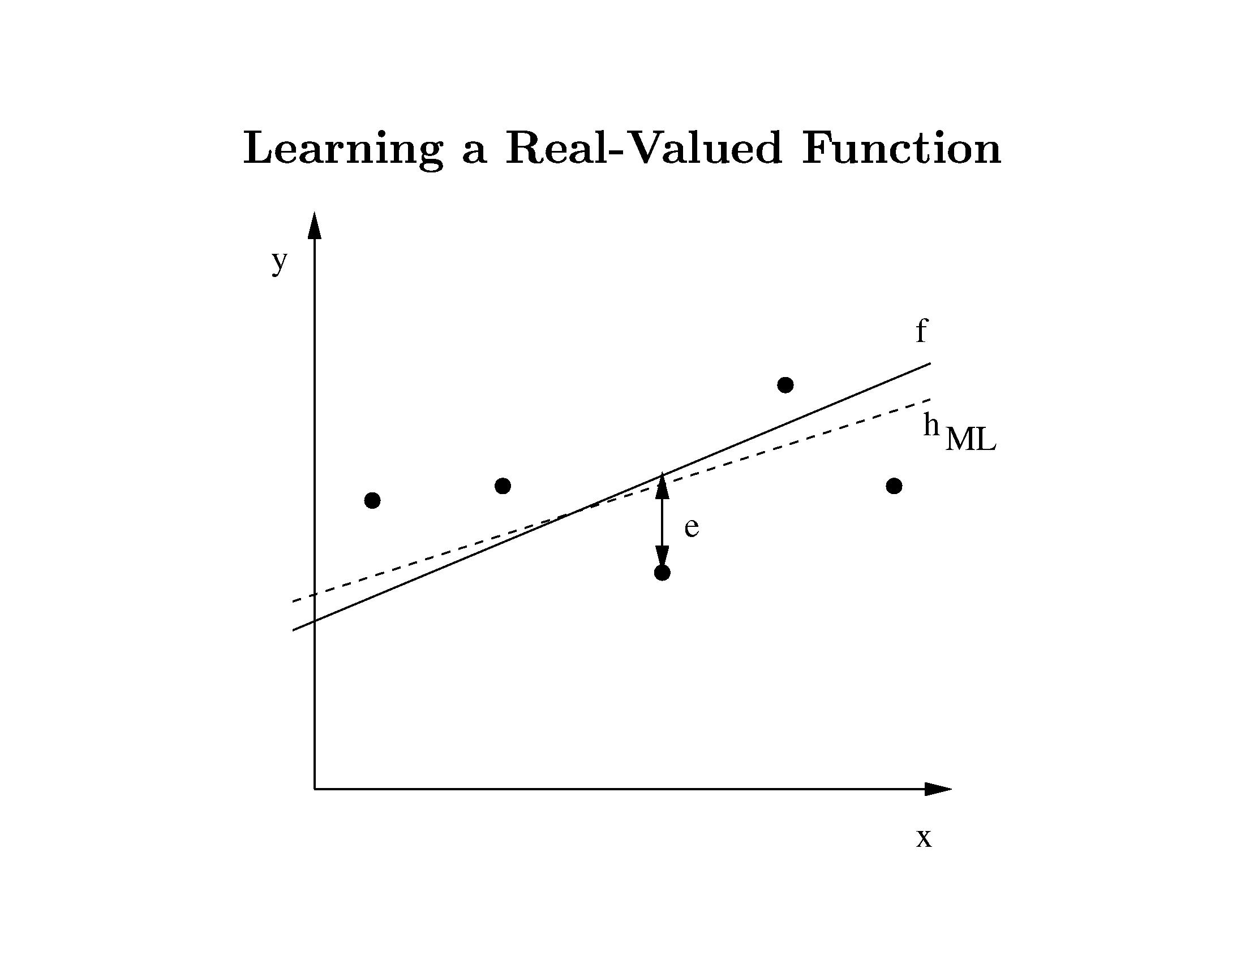
Bayesian Learning

Slide 14
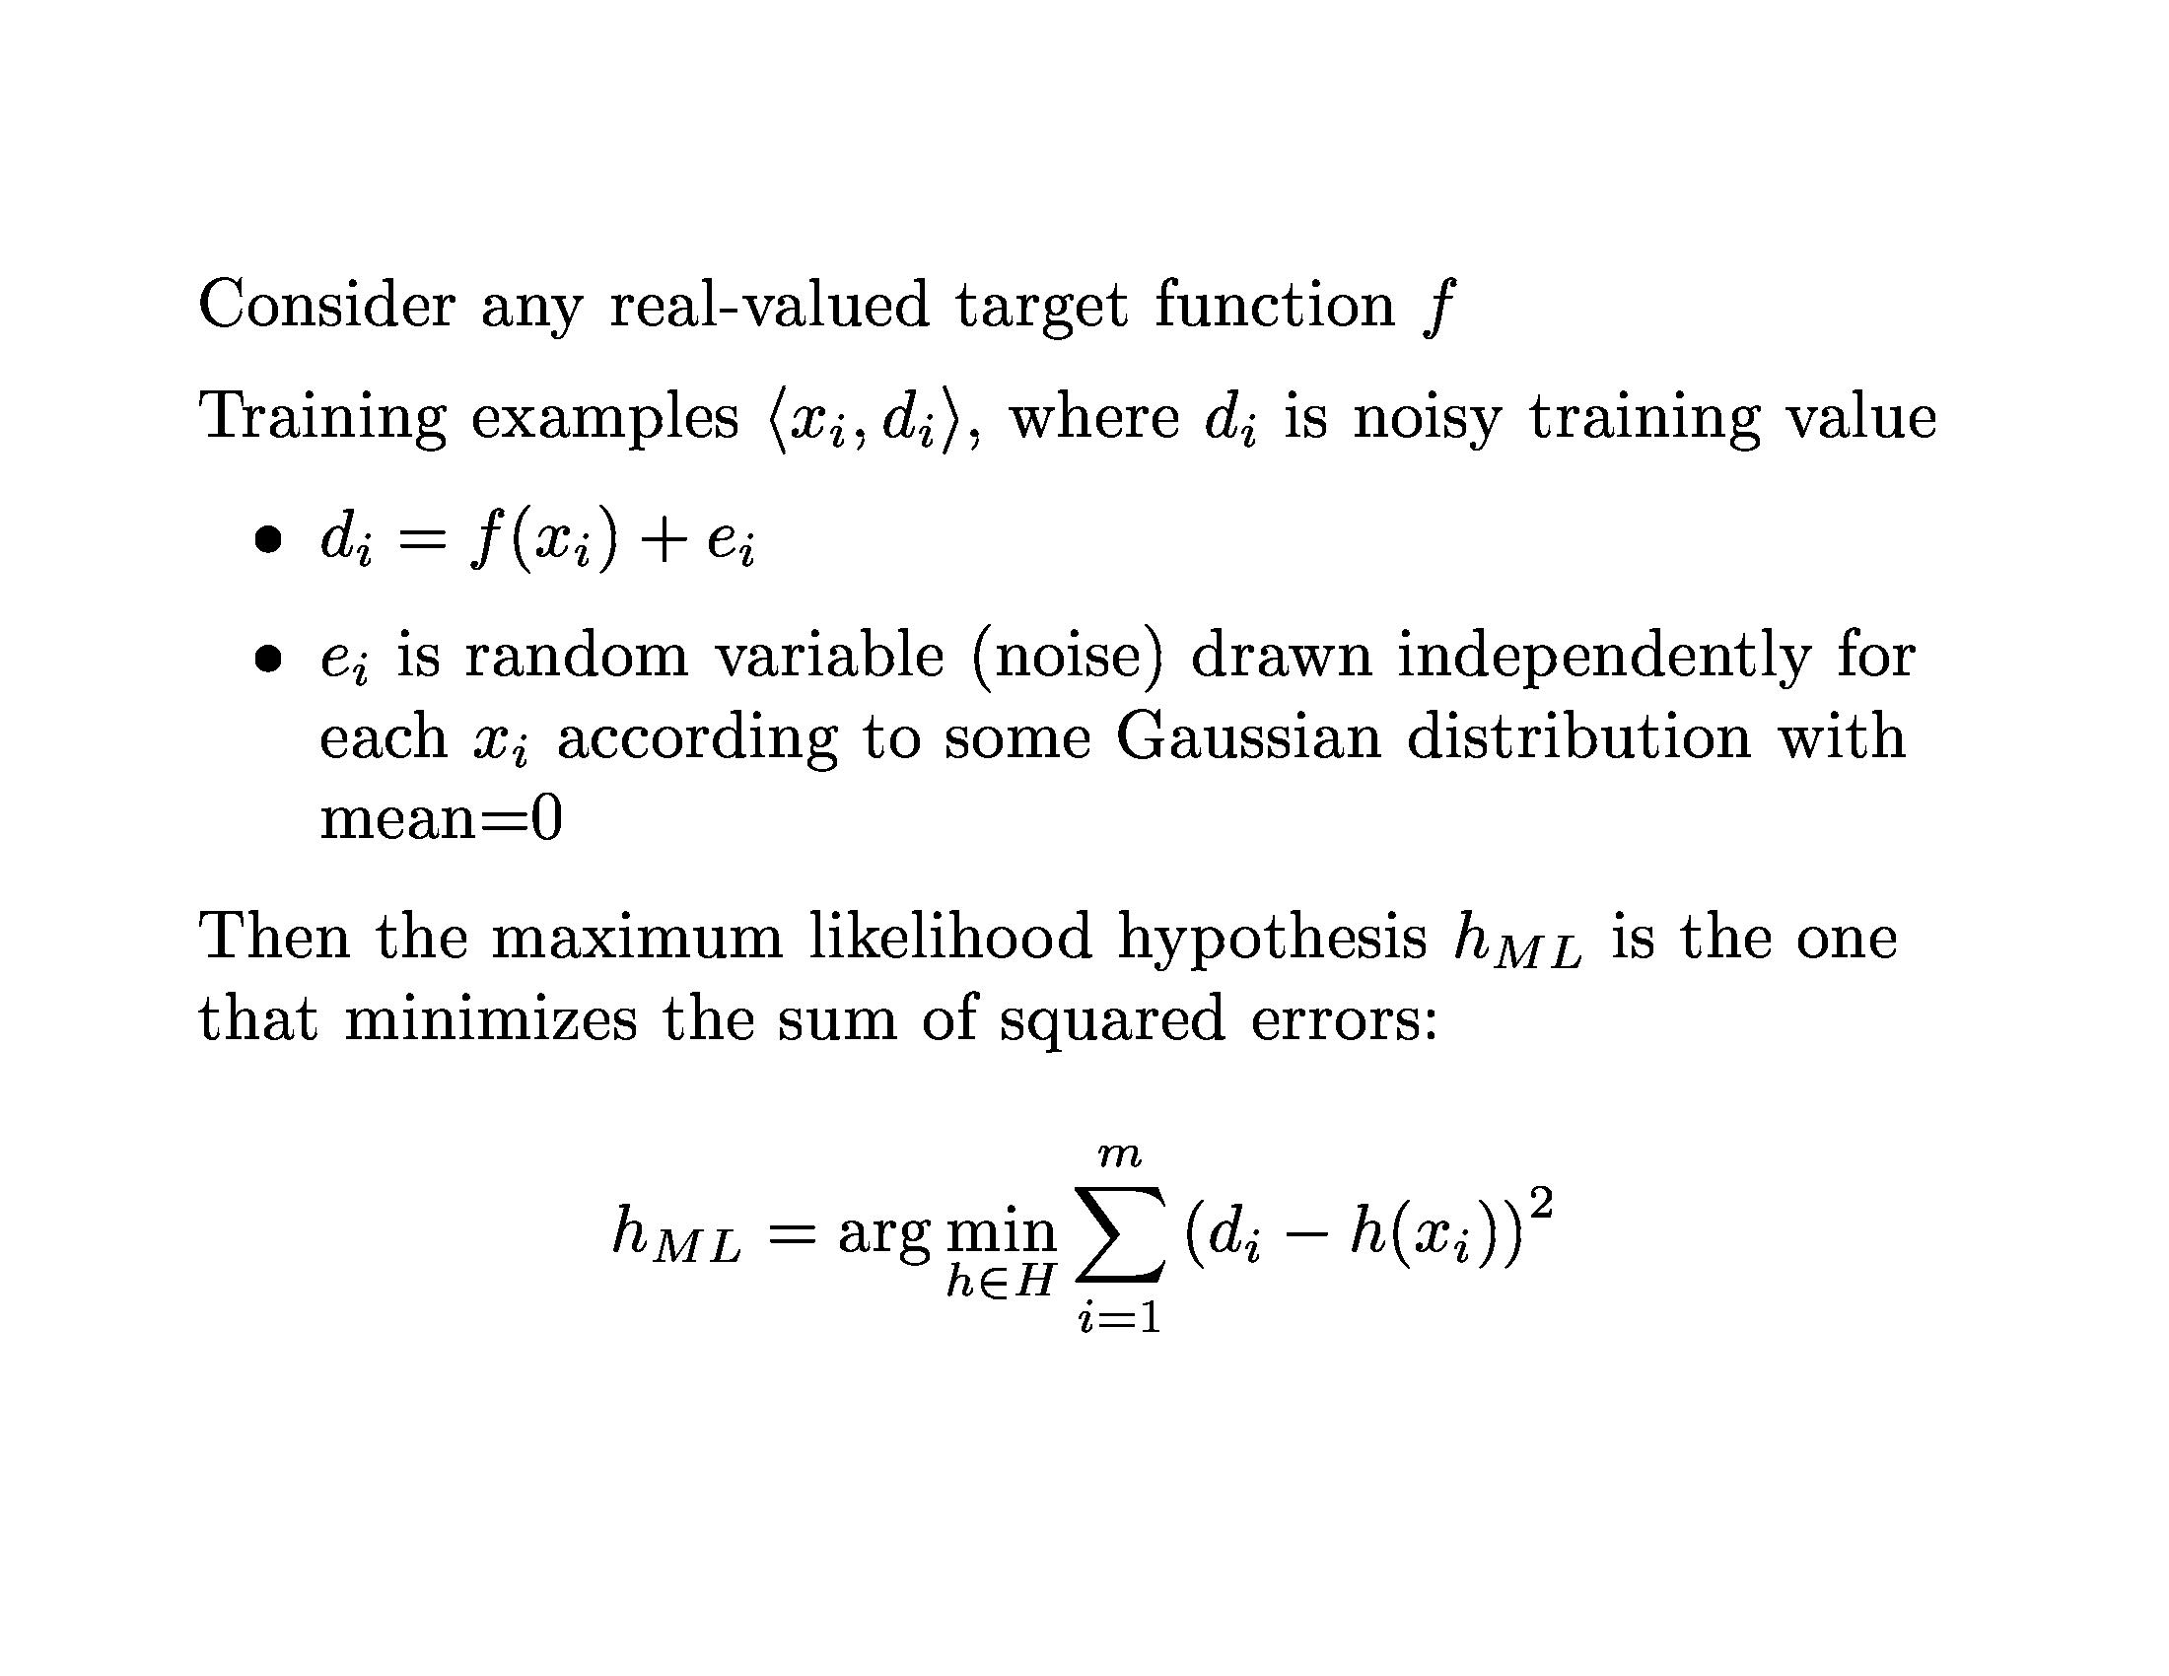
Bayesian Learning

Slide 15
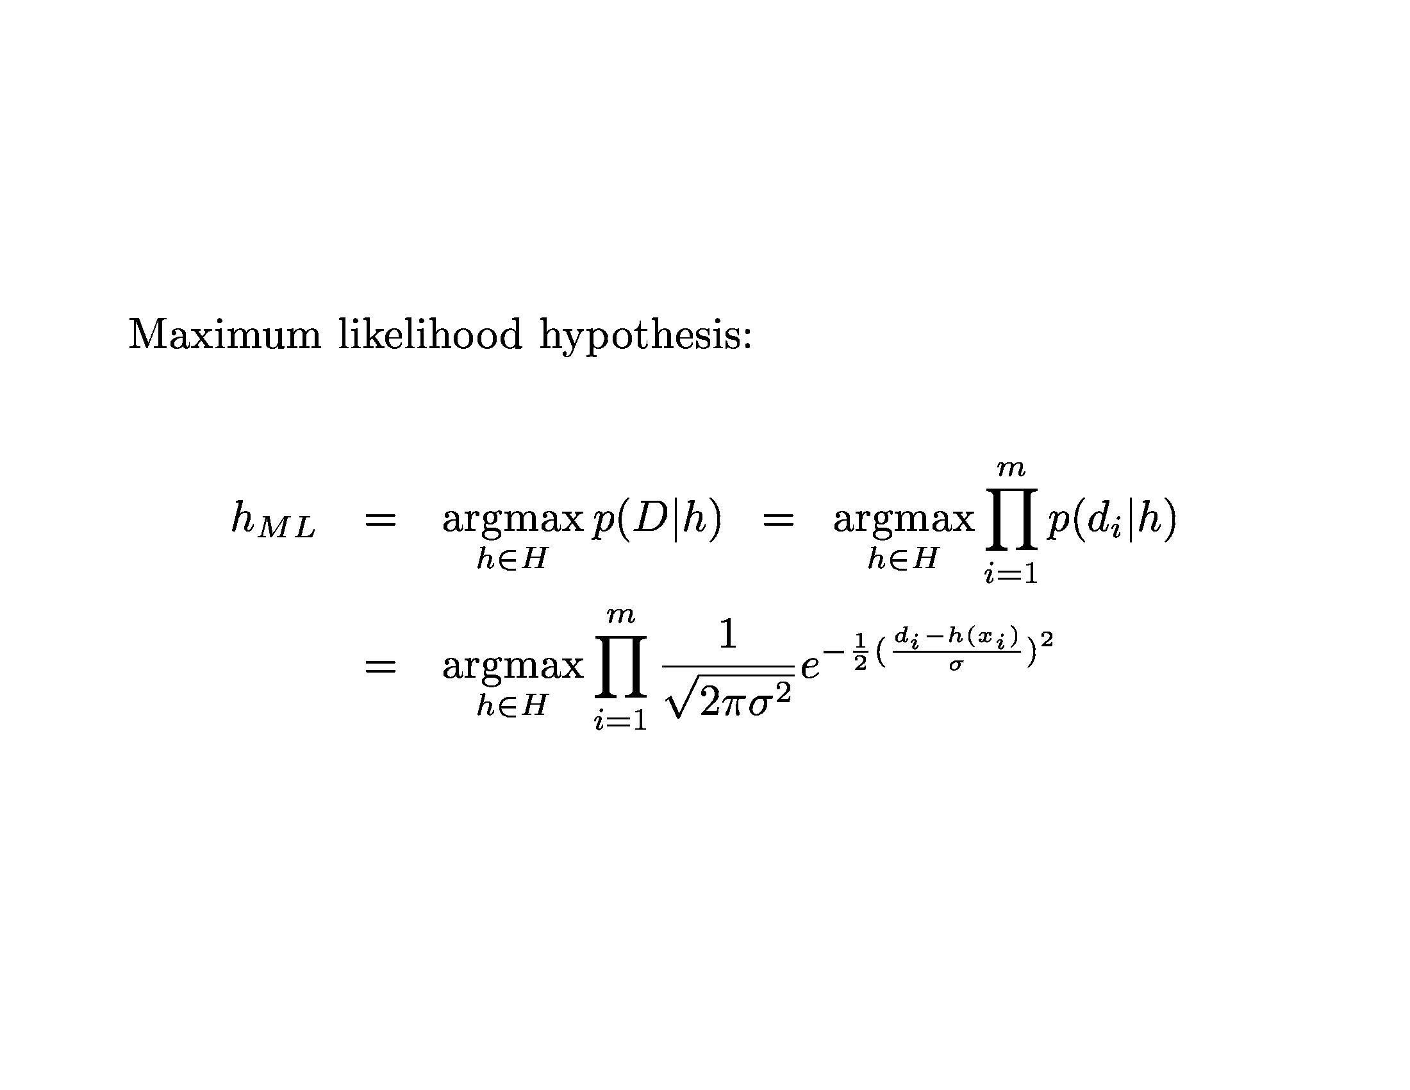
Bayesian Learning

Slide 16
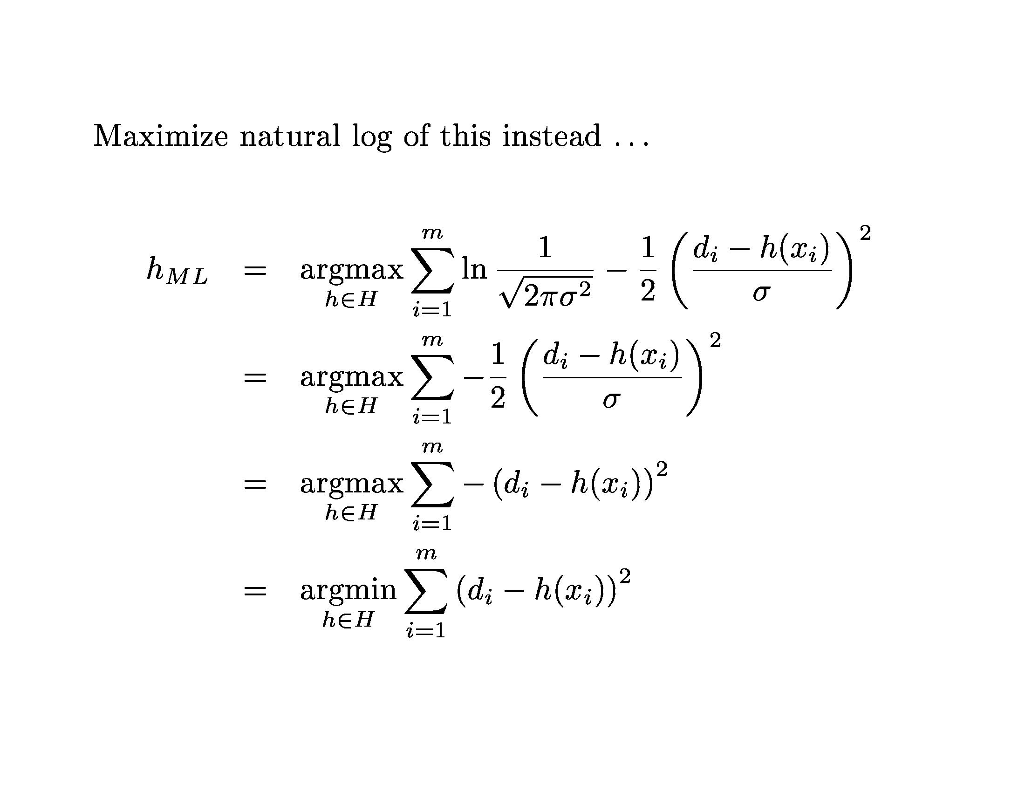
Bayesian Learning

Slide 17
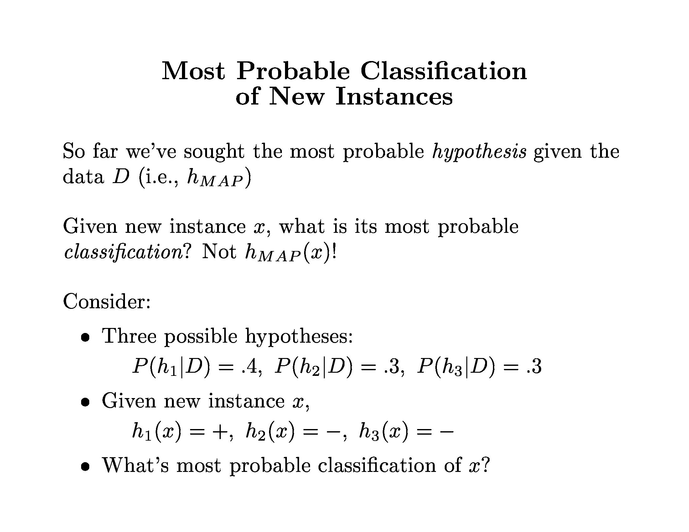
Bayesian Learning

Slide 18
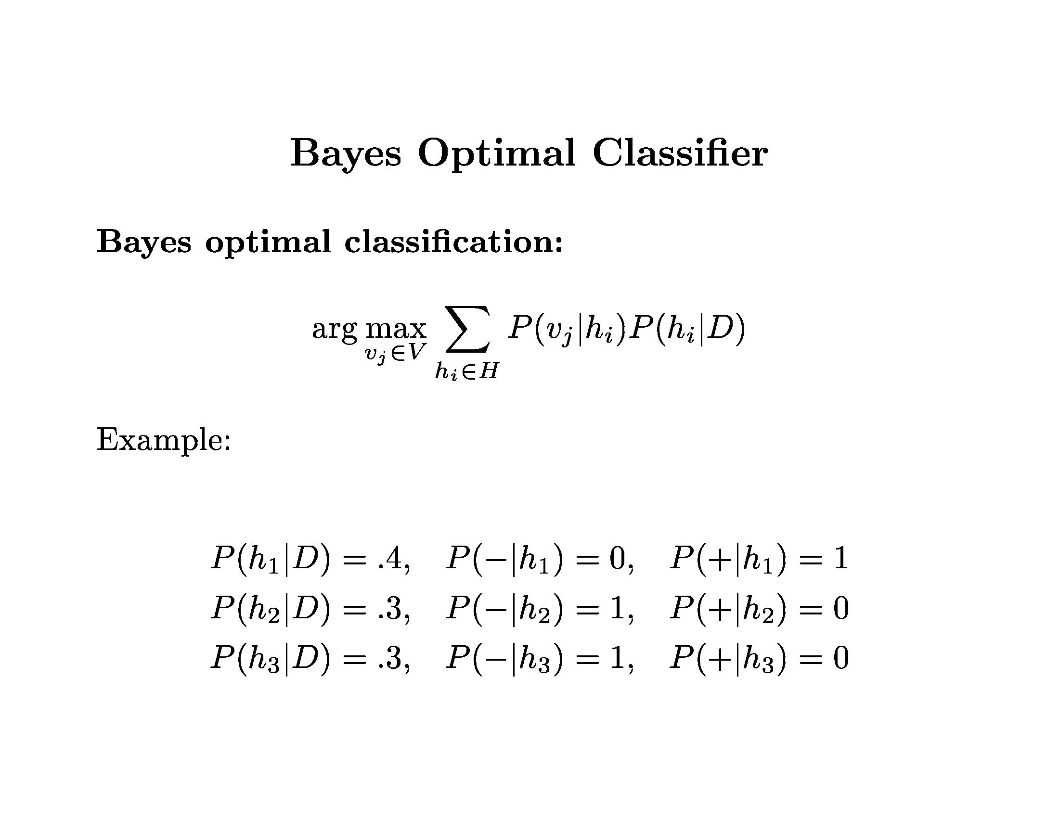
Bayesian Learning

Slide 19
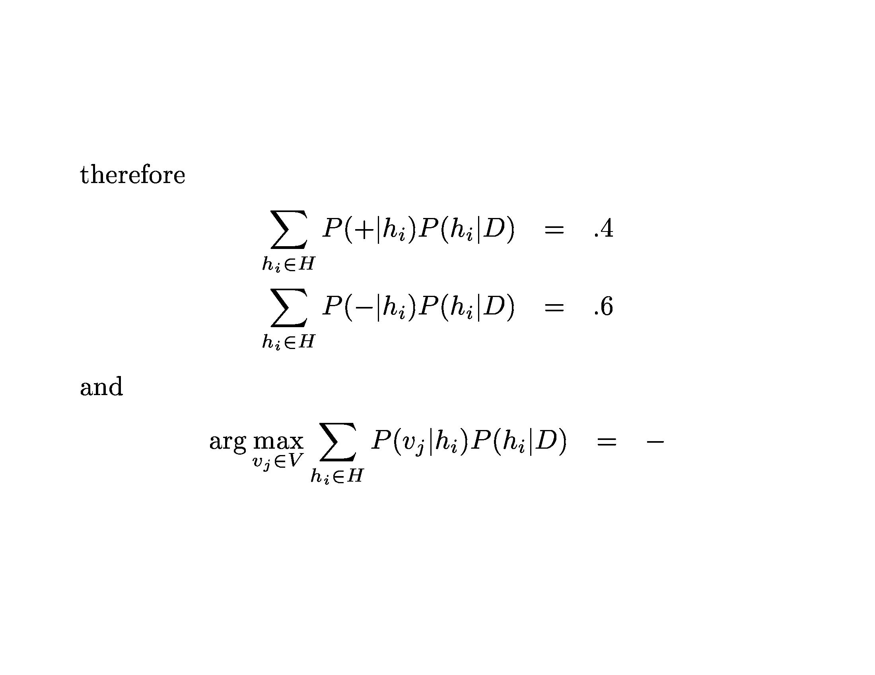
Bayesian Learning

Slide 20
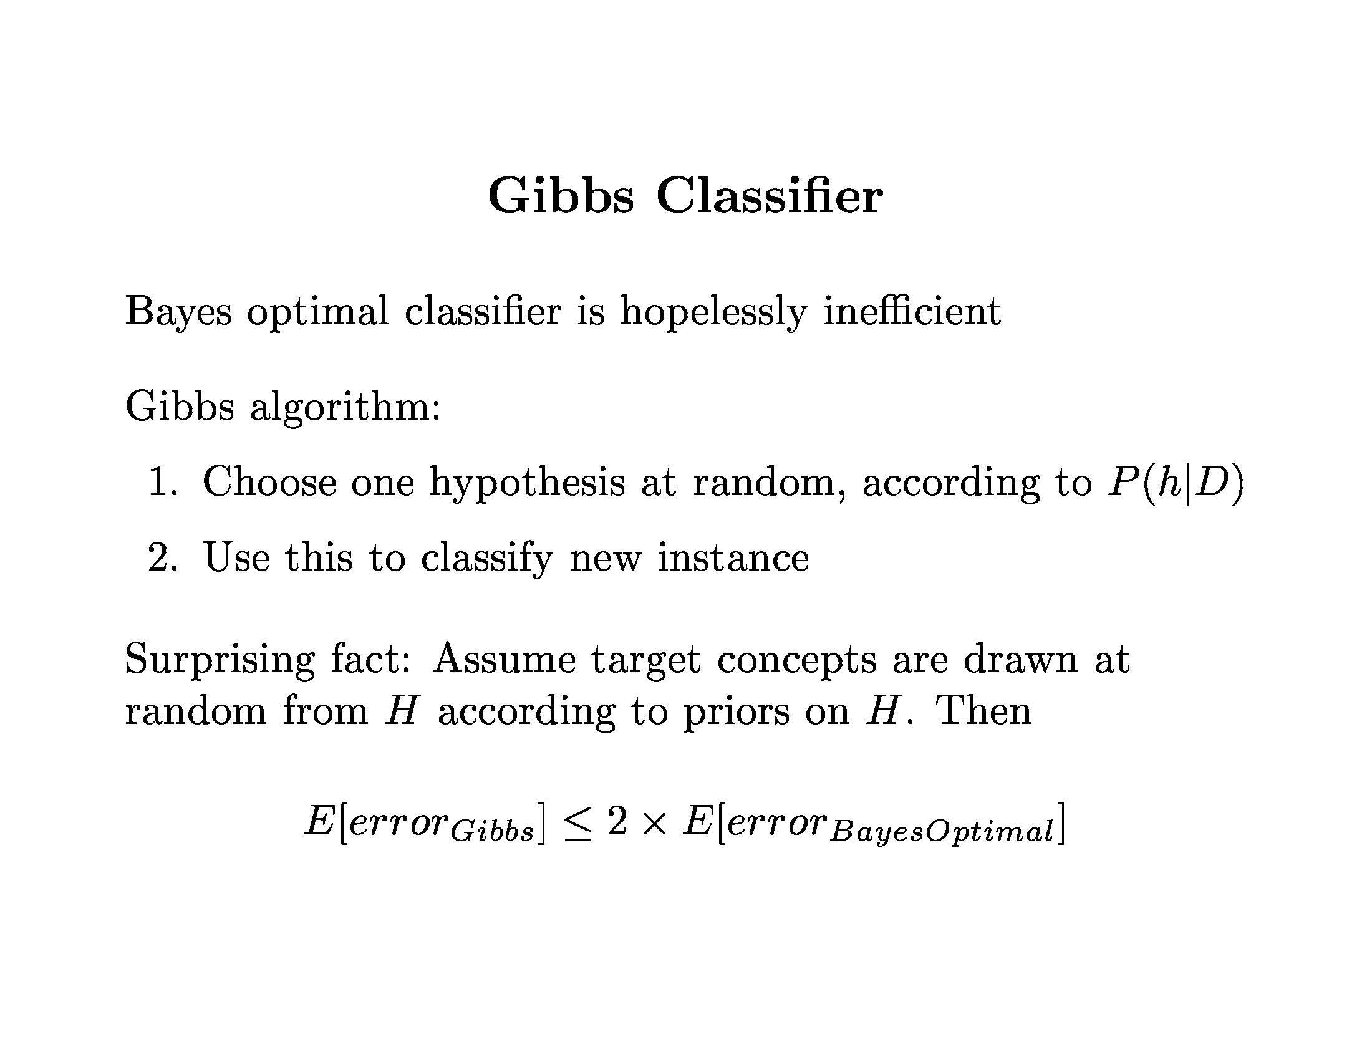
Bayesian Learning

Slide 21
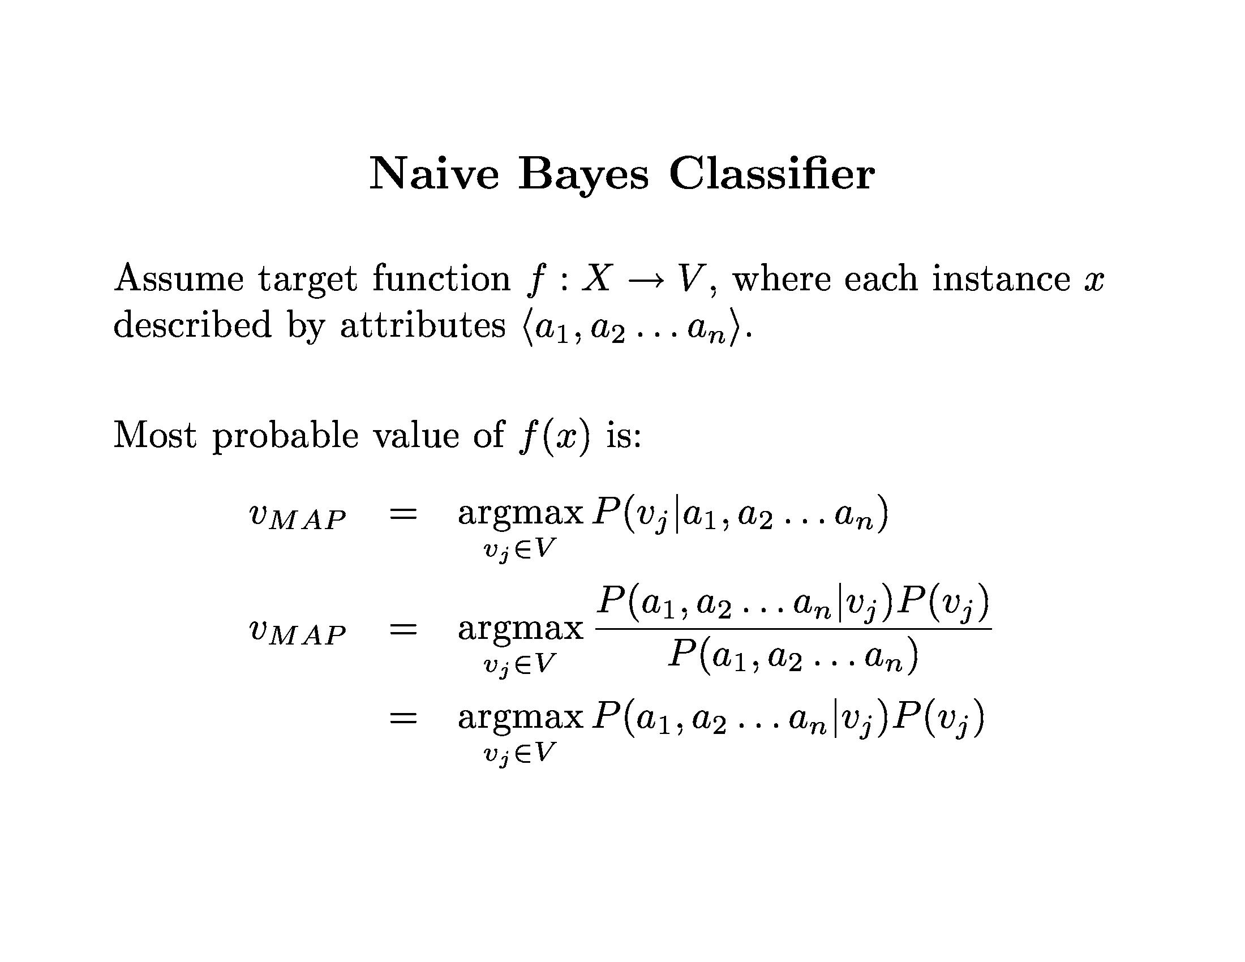
Bayesian Learning

Slide 22
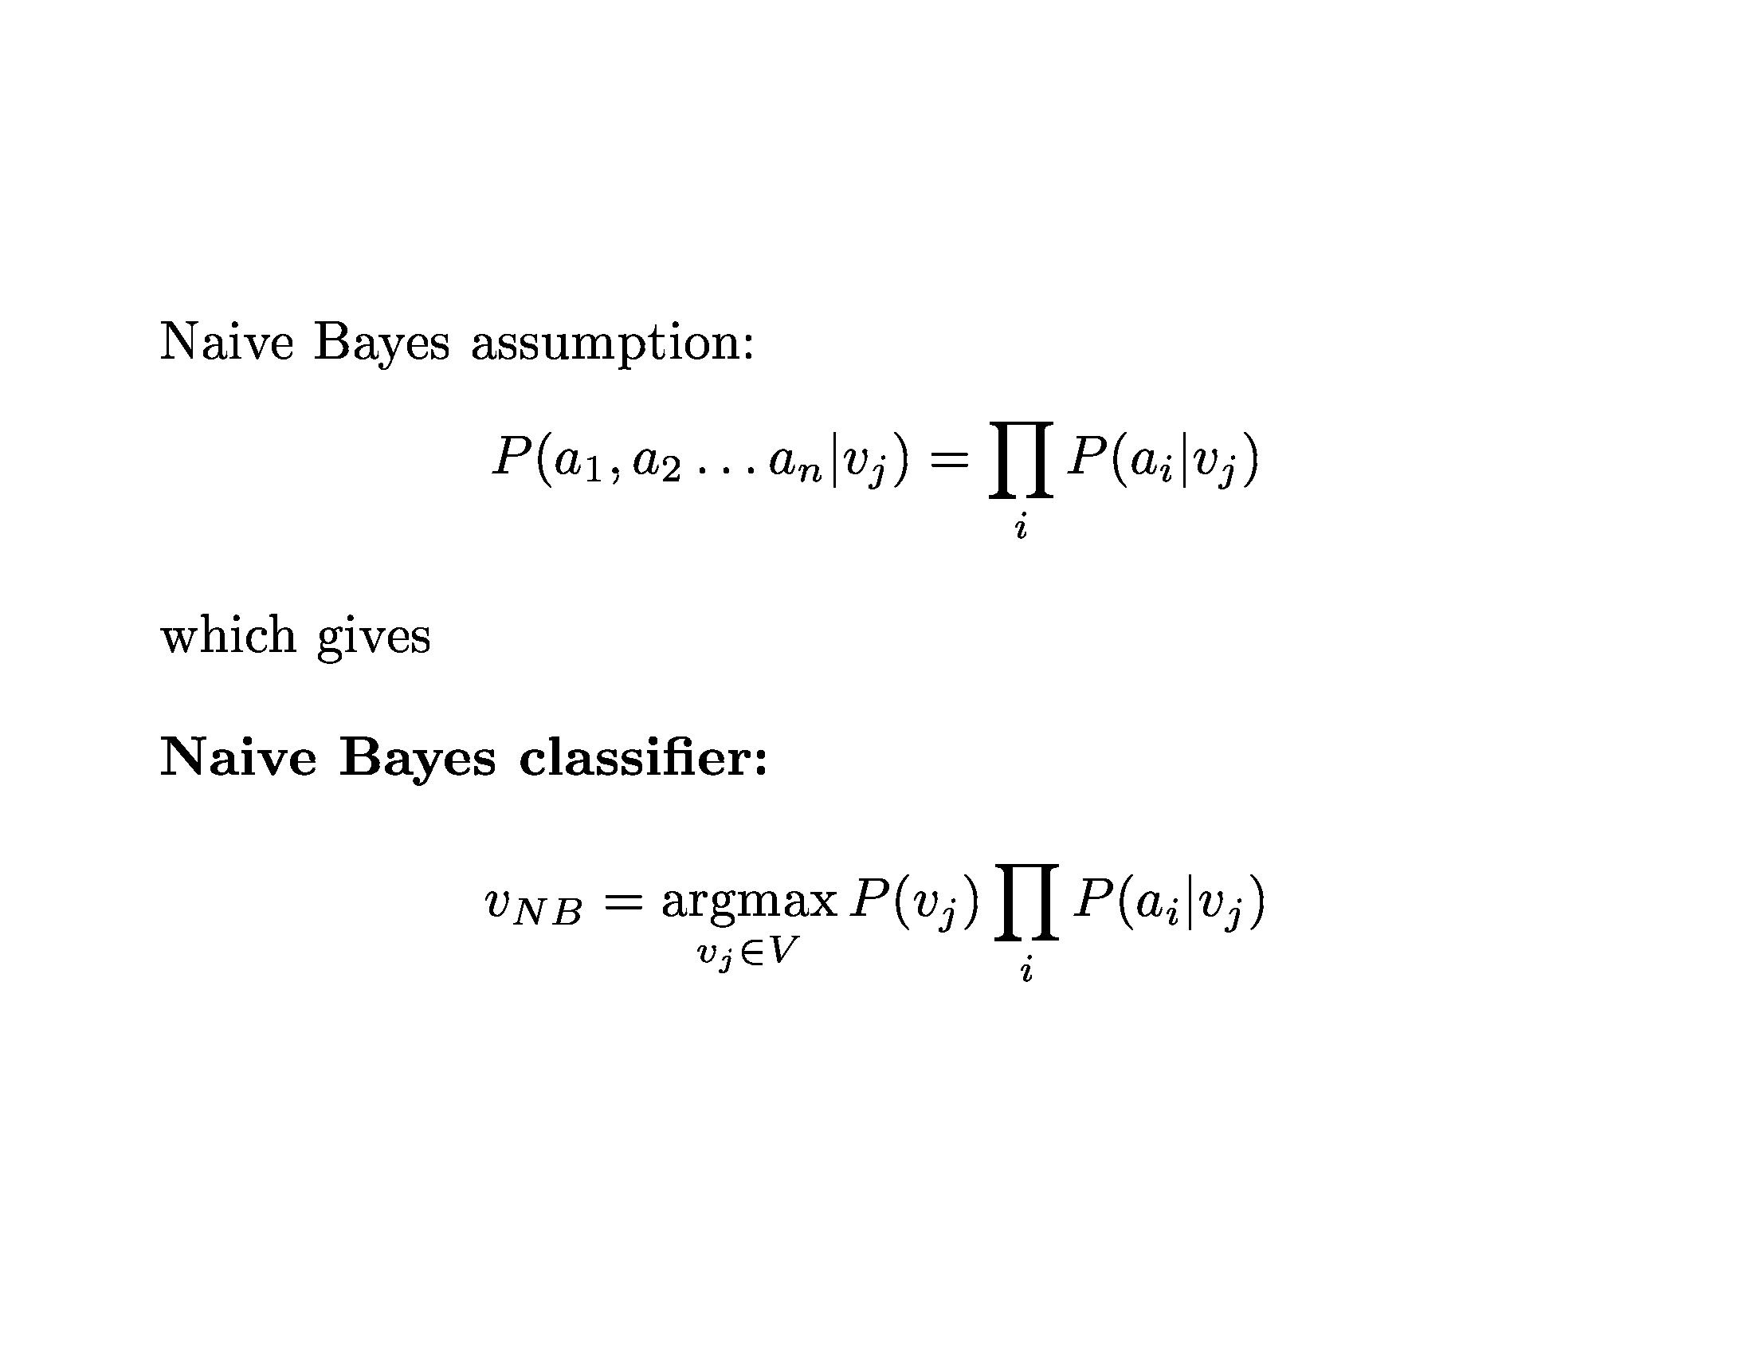
Bayesian Learning

Slide 23
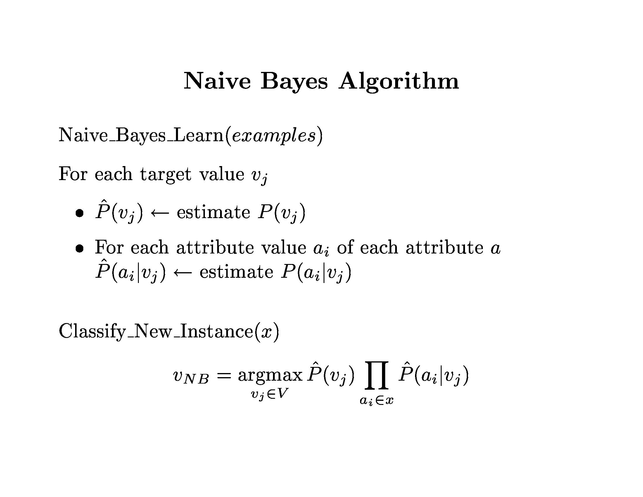

Slide 24
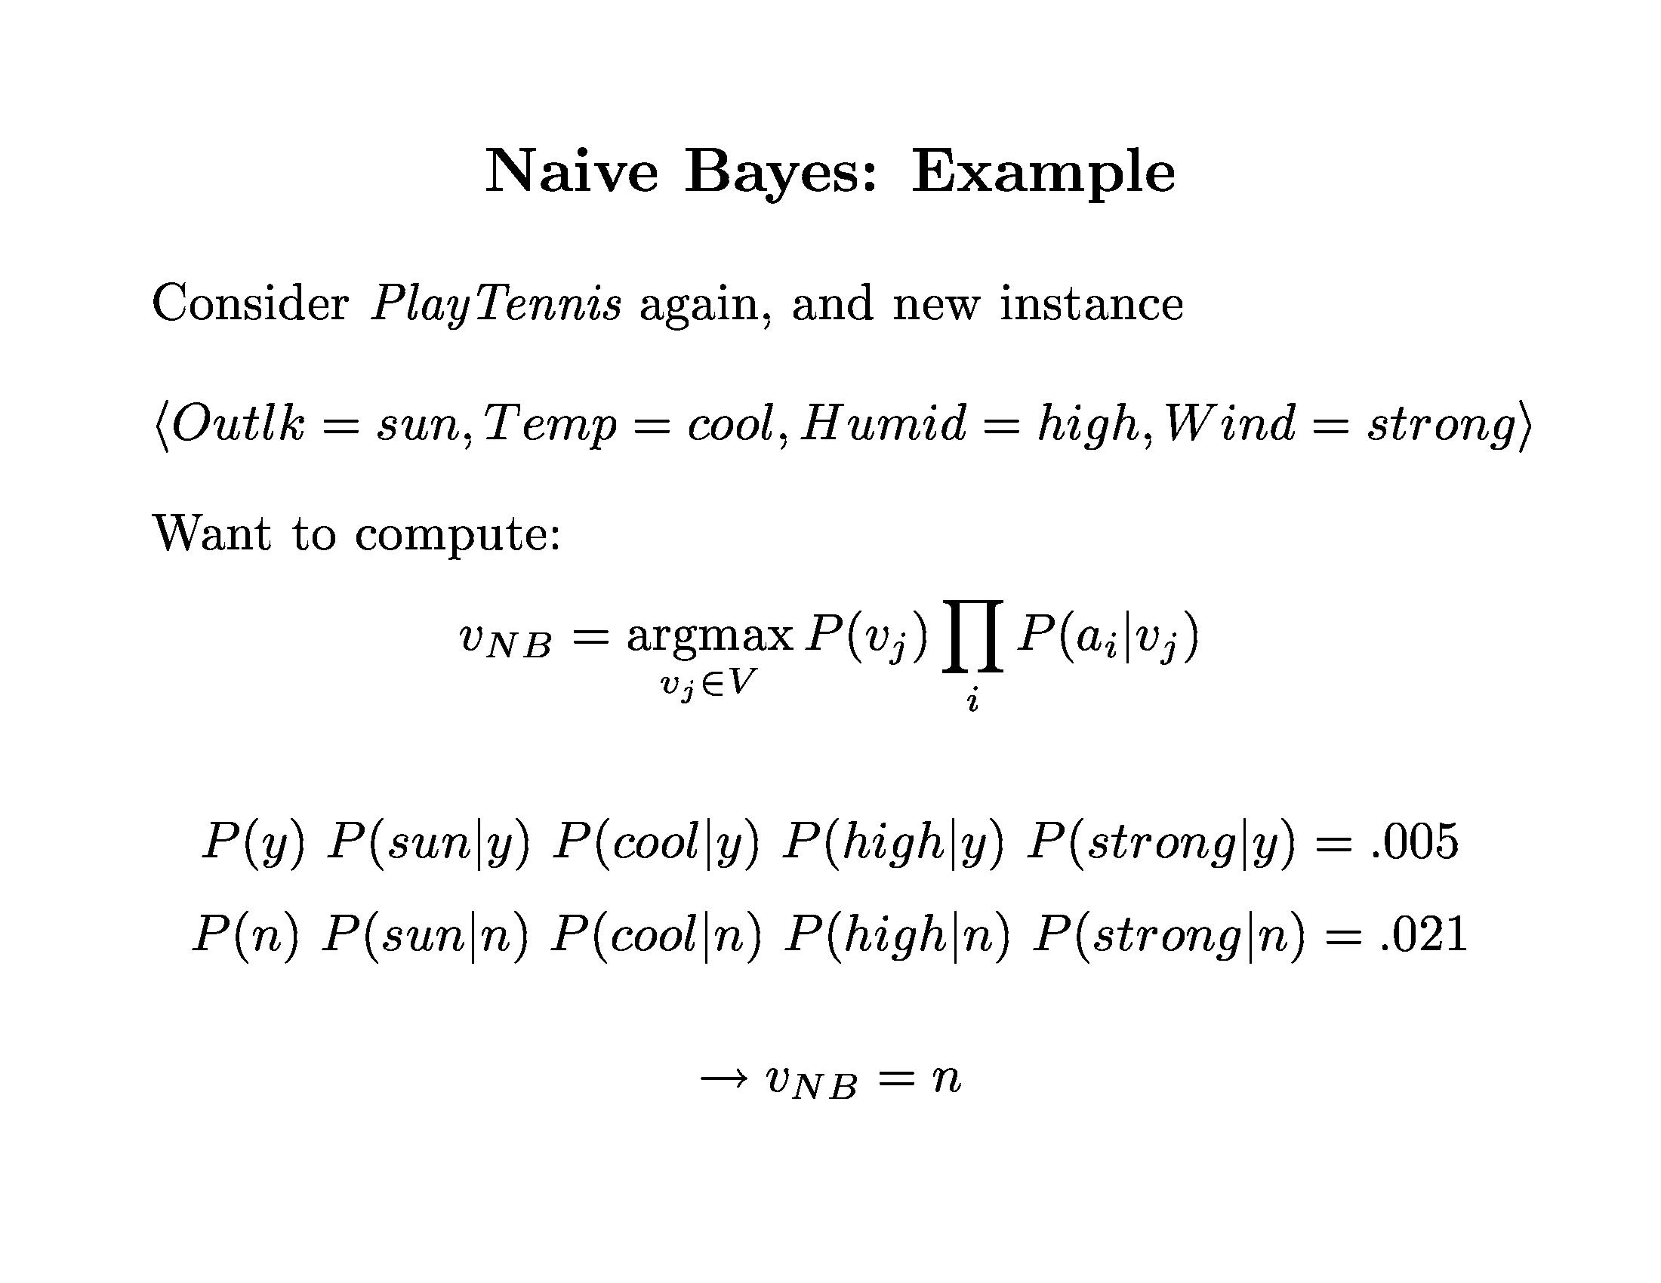
Bayesian Learning

Slide 25
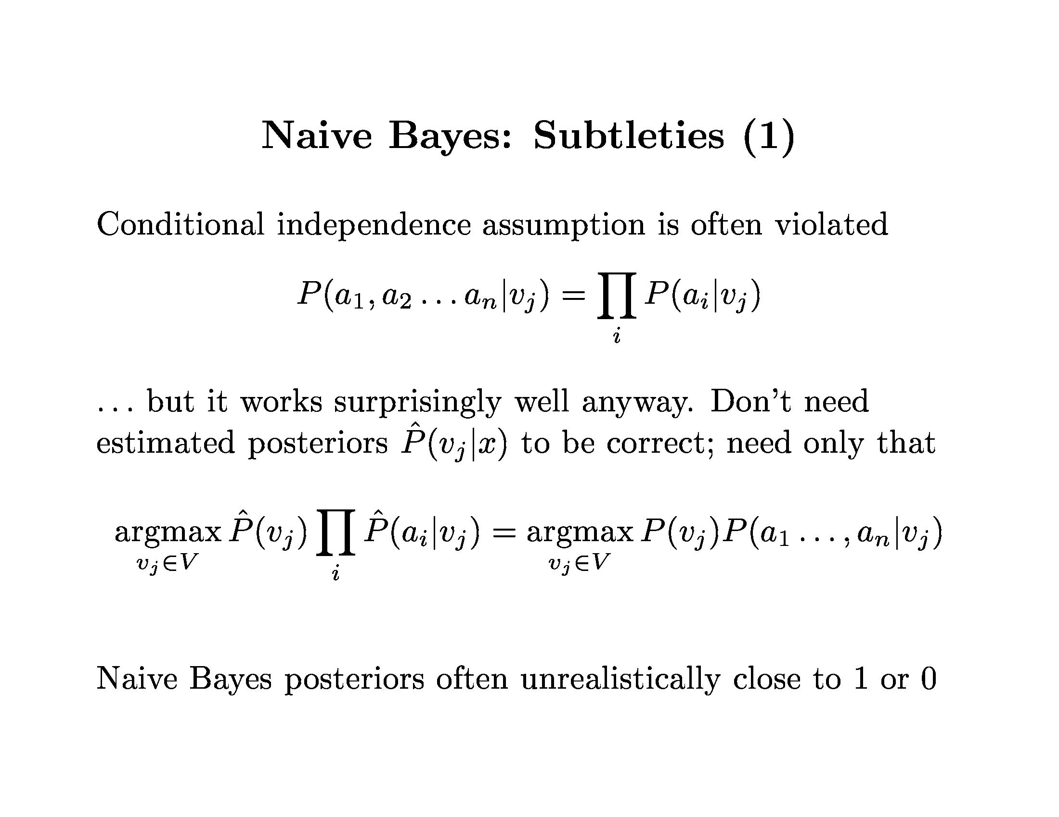
Bayesian Learning

Slide 26
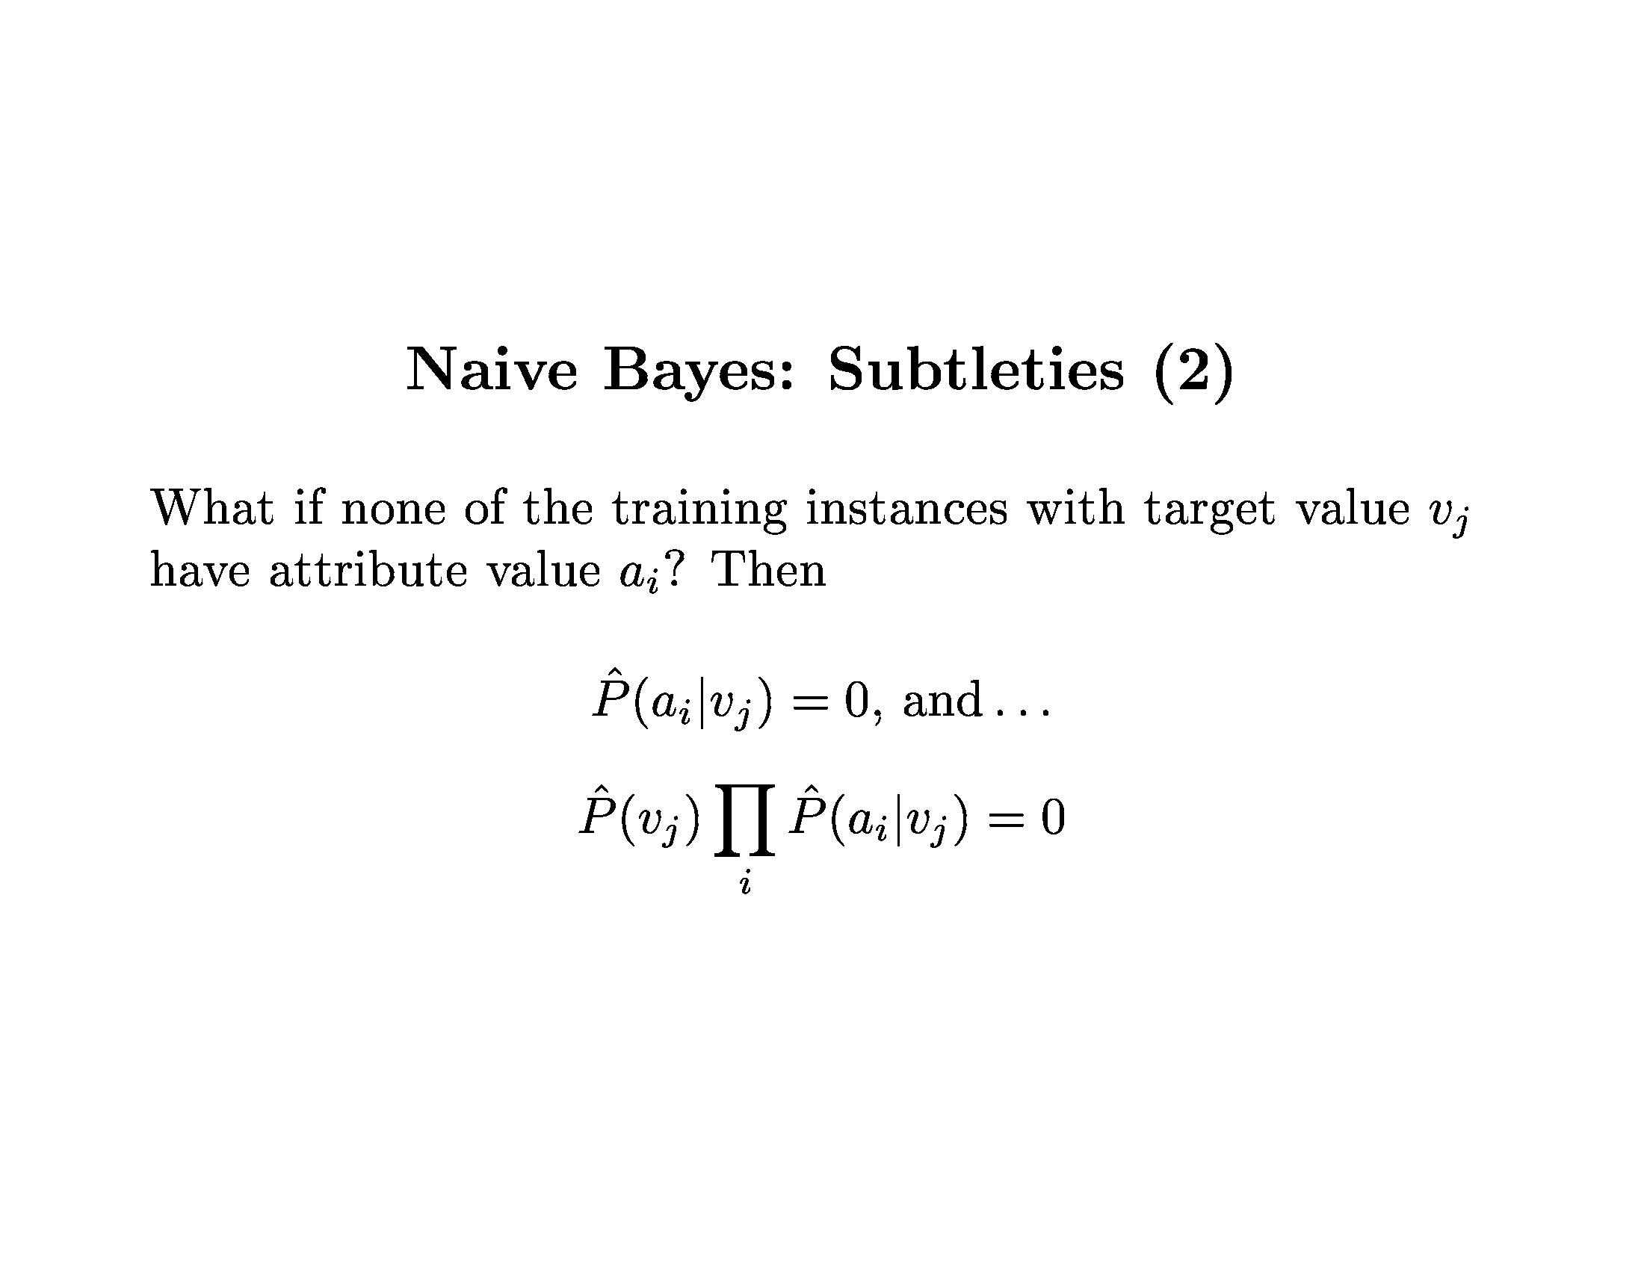
Bayesian Learning

Slide 27
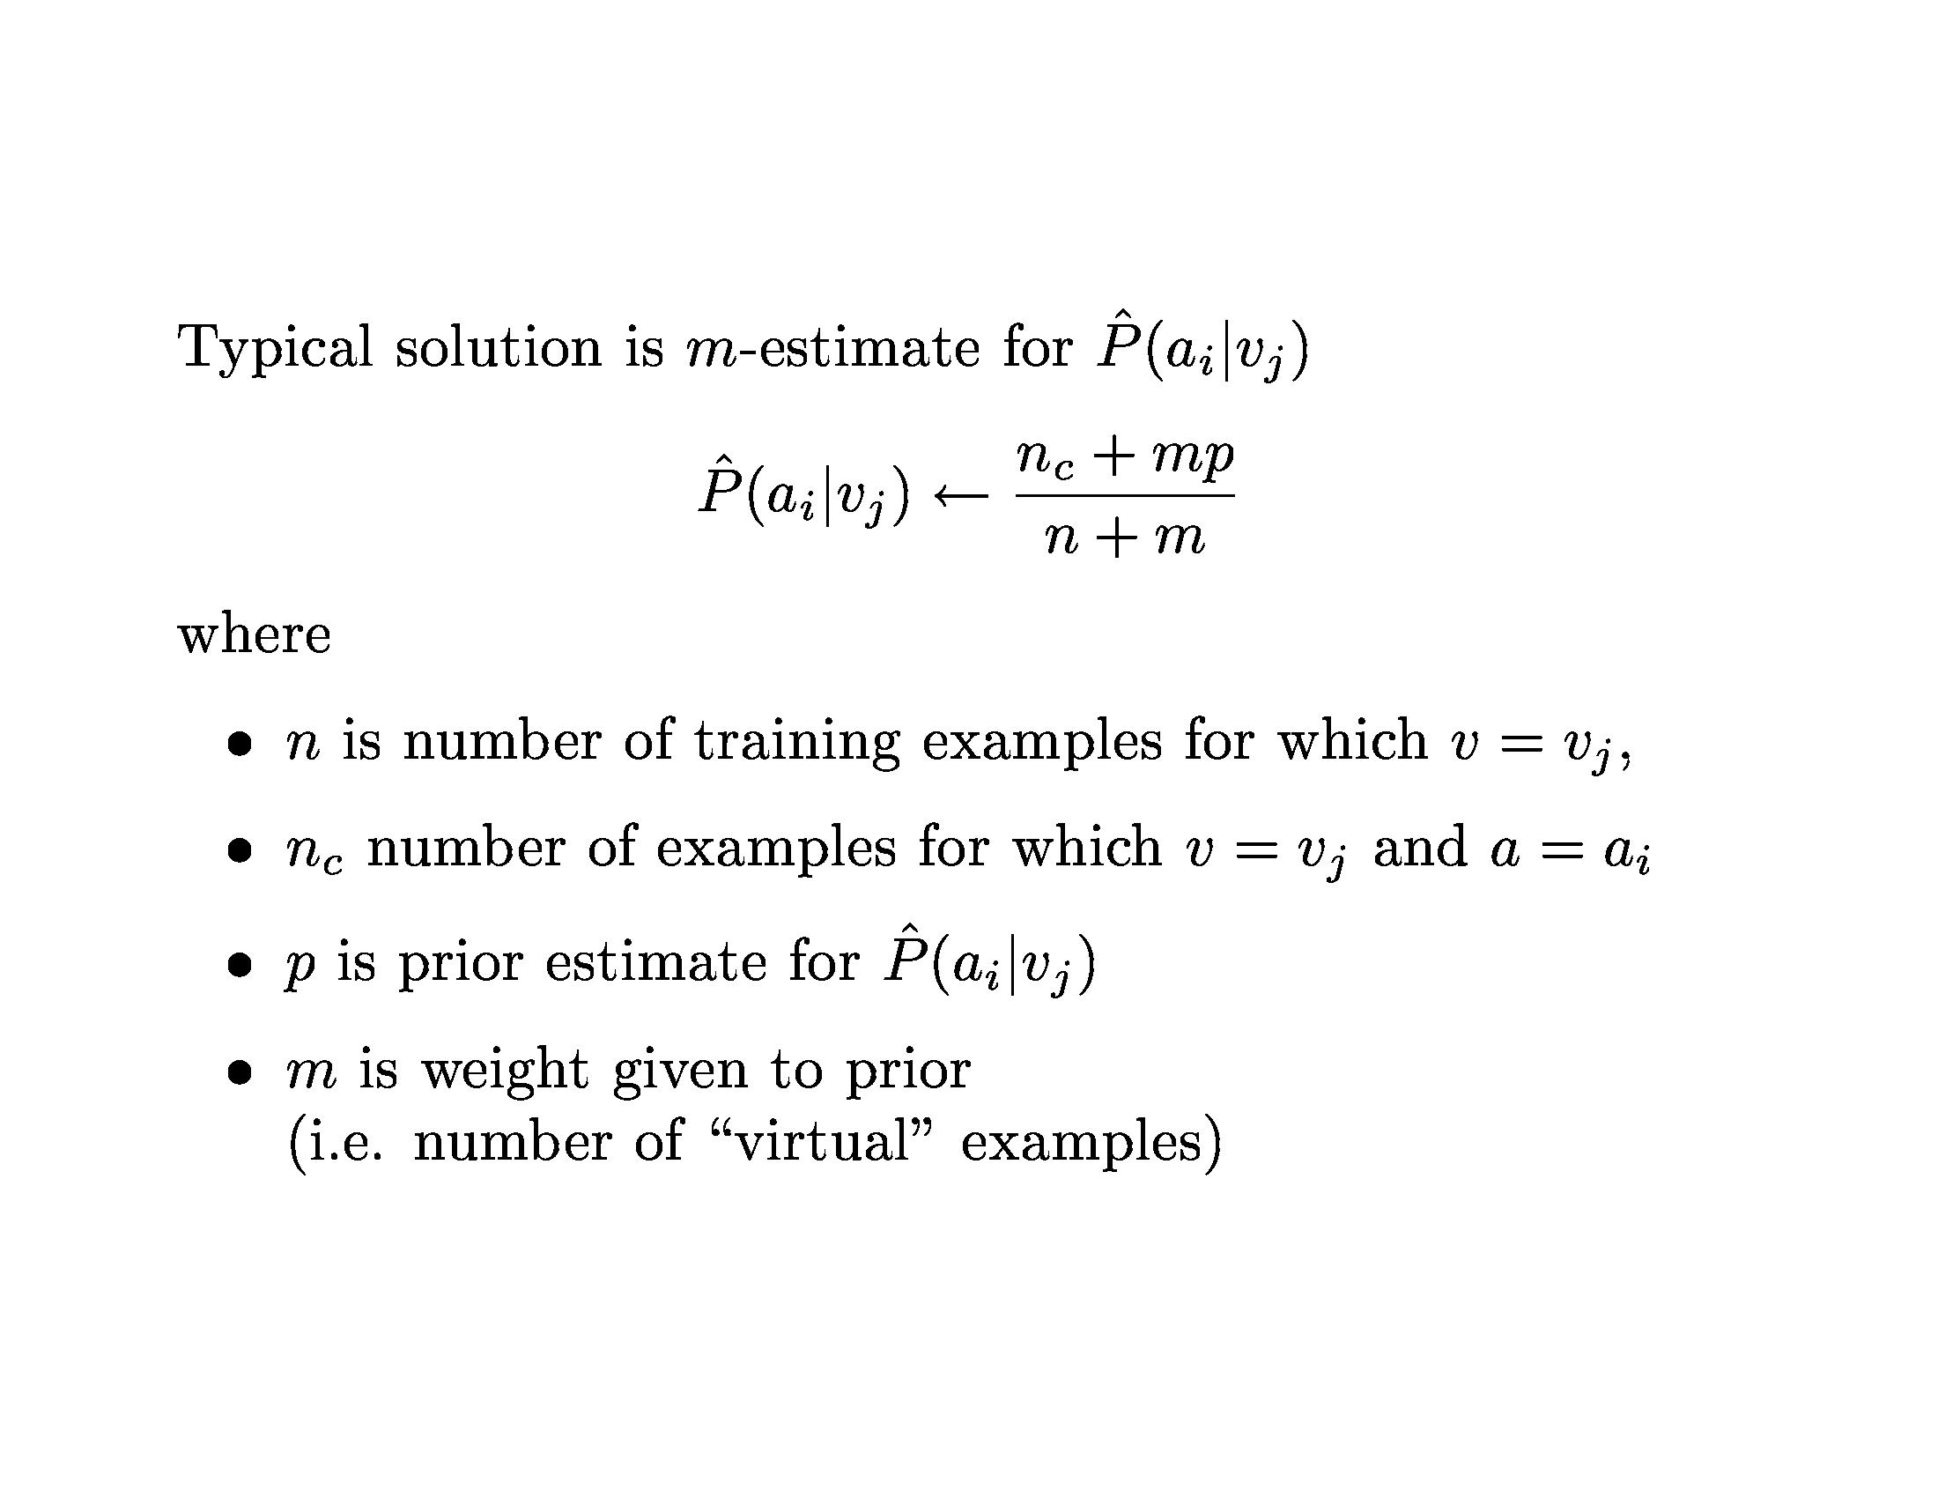
Bayesian Learning

Slide 28
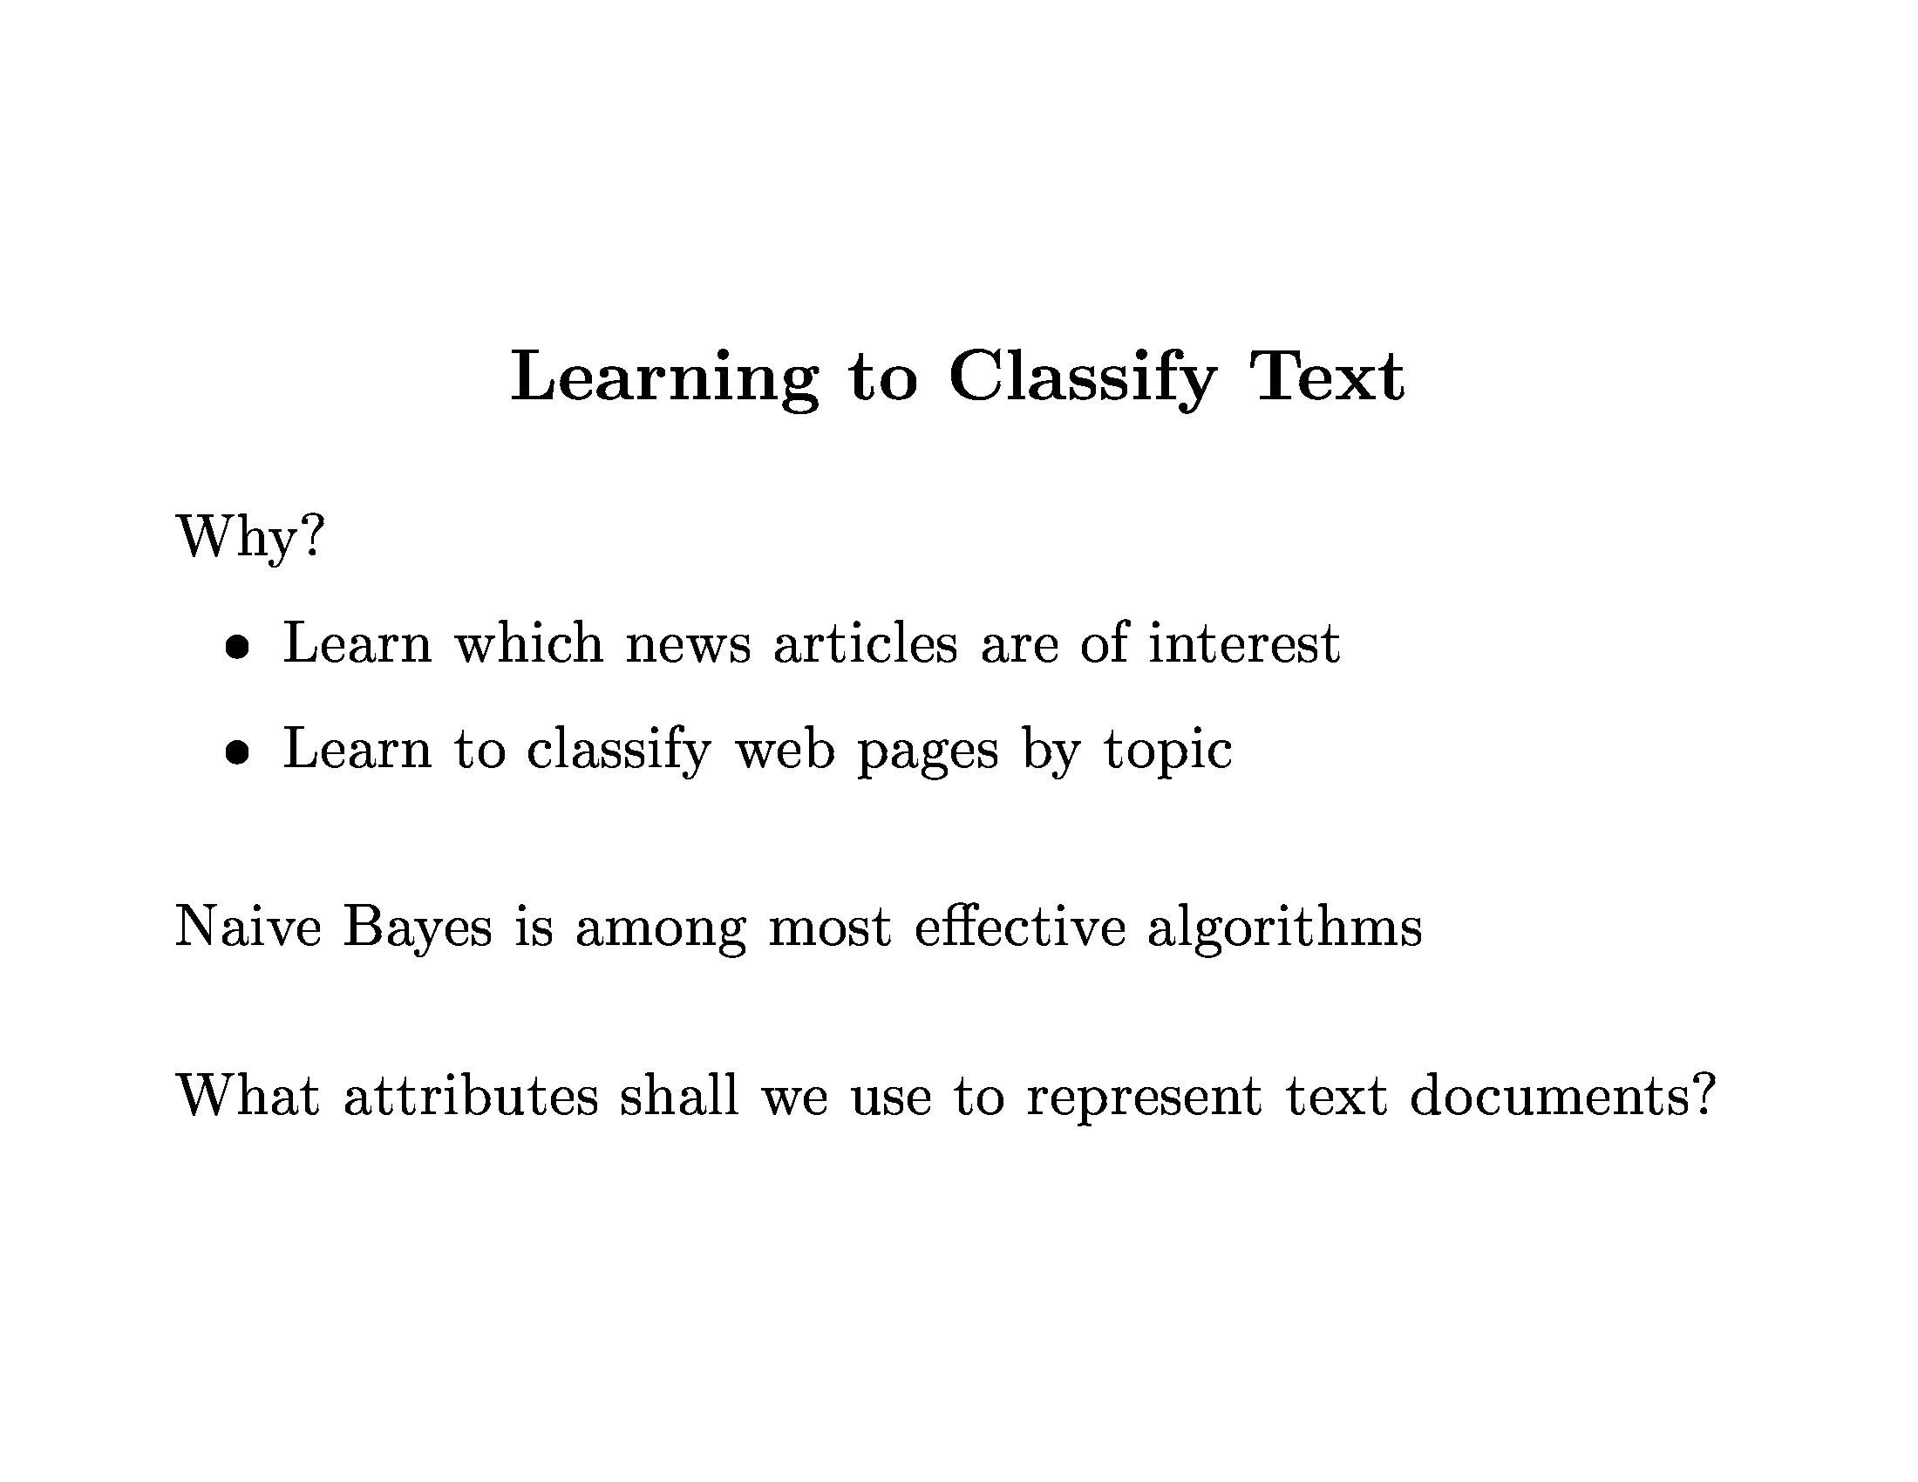
Bayesian Learning

Slide 29
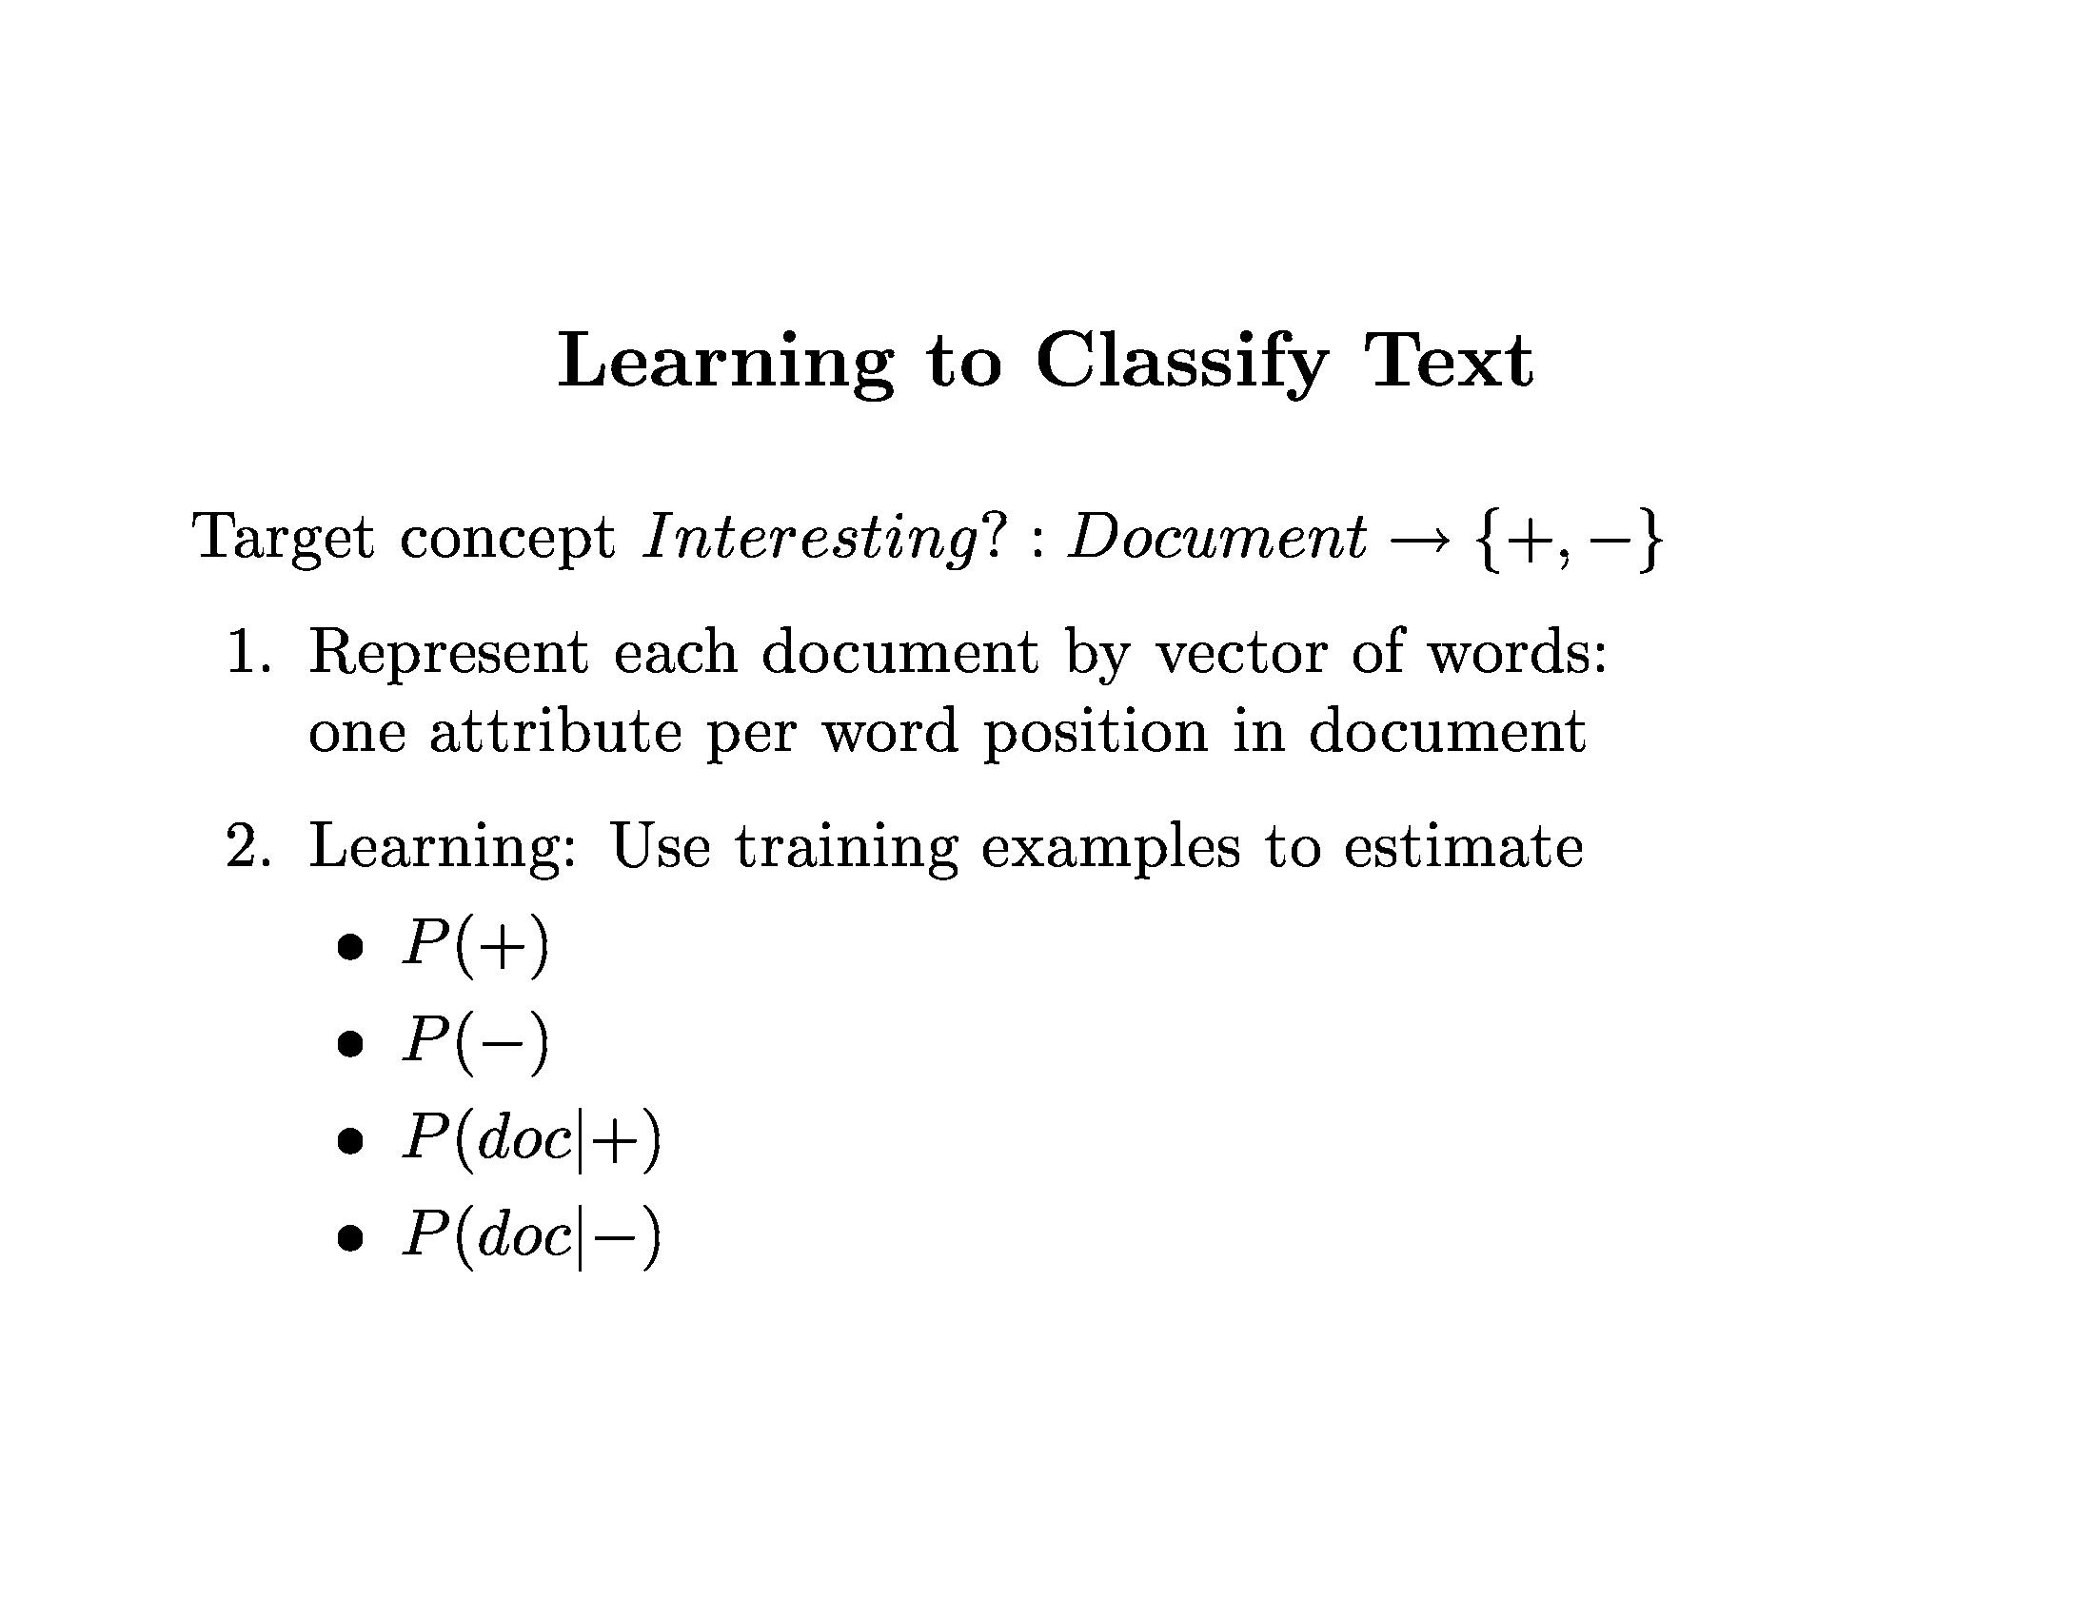
Bayesian Learning

Slide 30
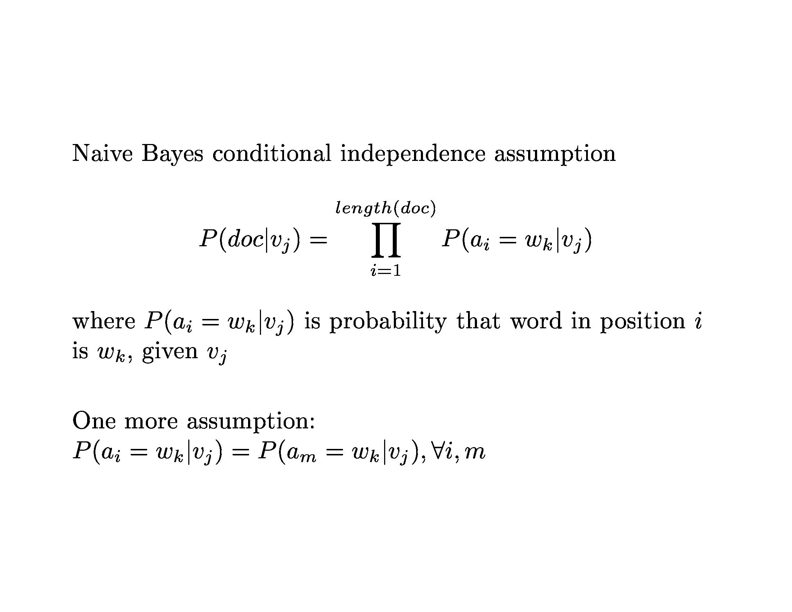
Bayesian Learning

Slide 31
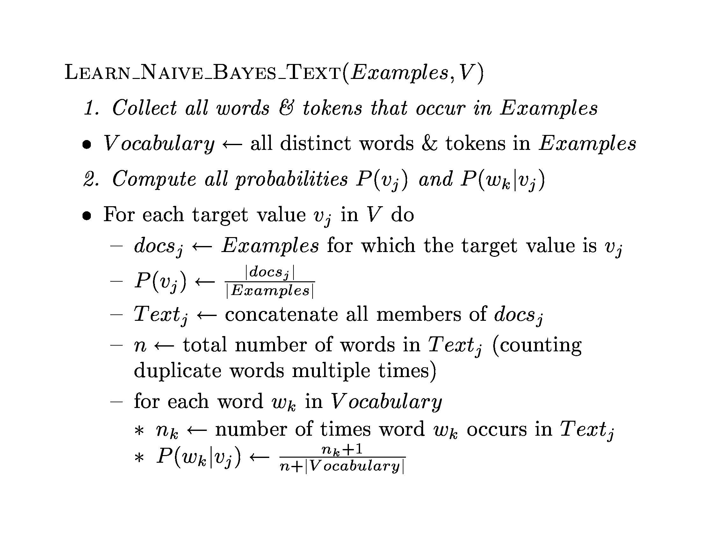
Bayesian Learning

Slide 32
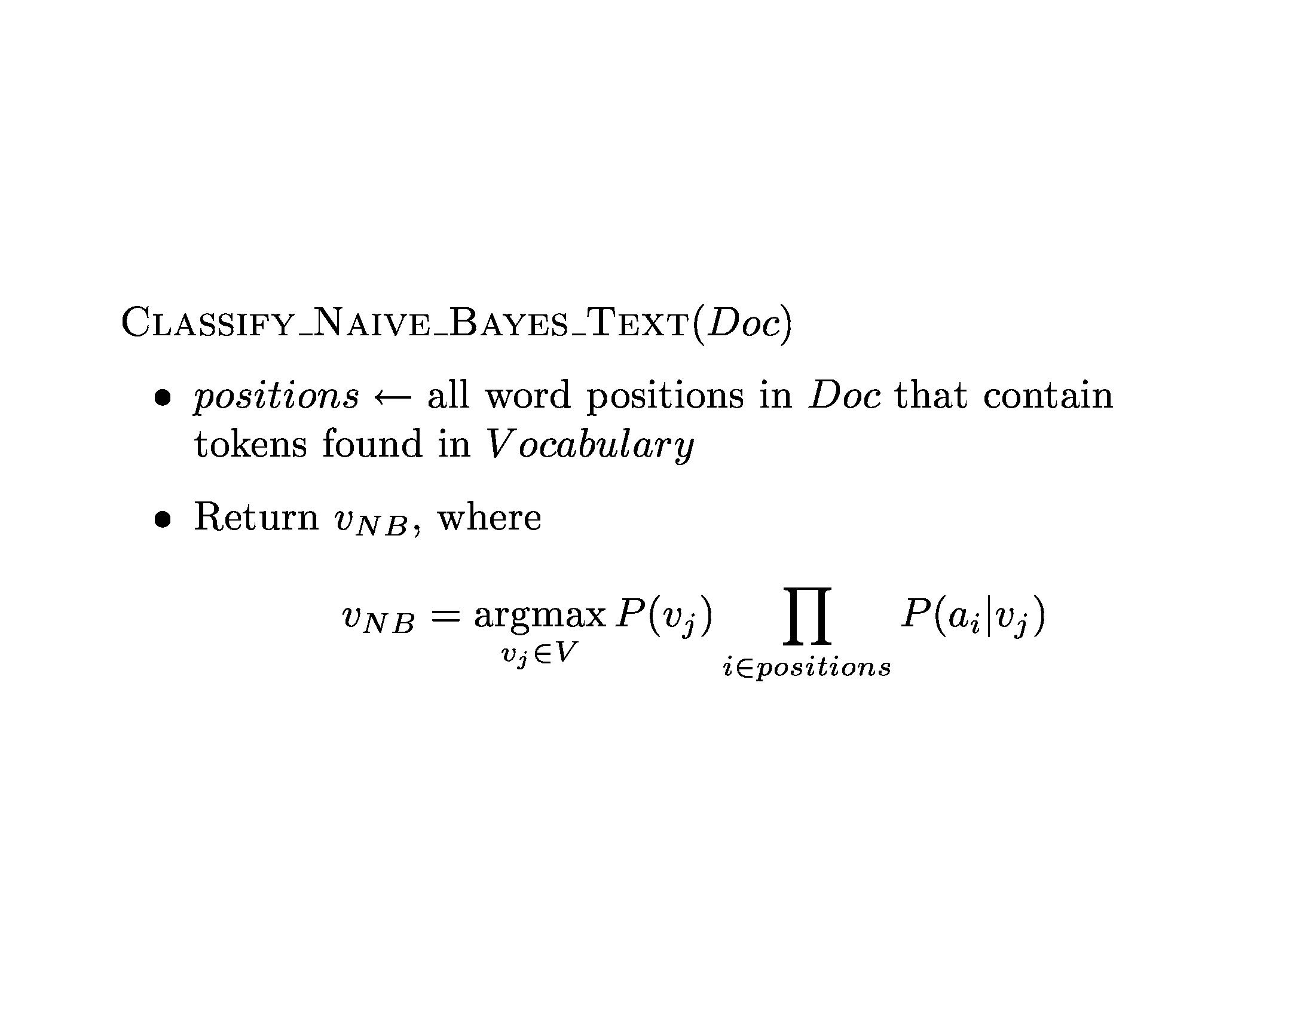
Bayesian Learning

Slide 33
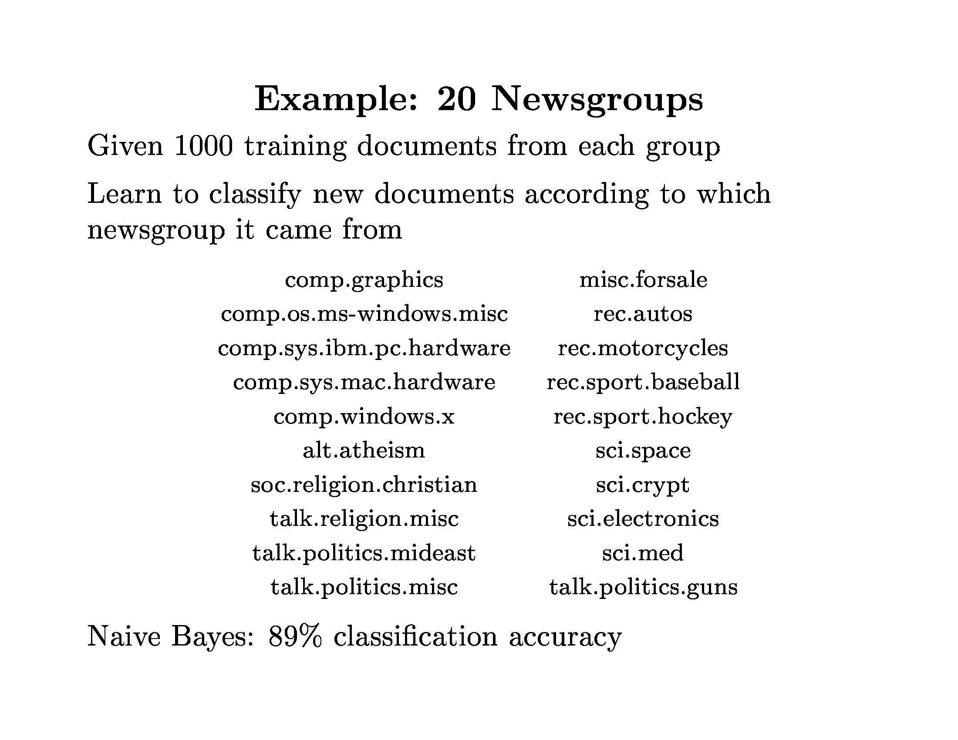
Bayesian Learning

Slide 34

Bayesian Learning

Slide 35
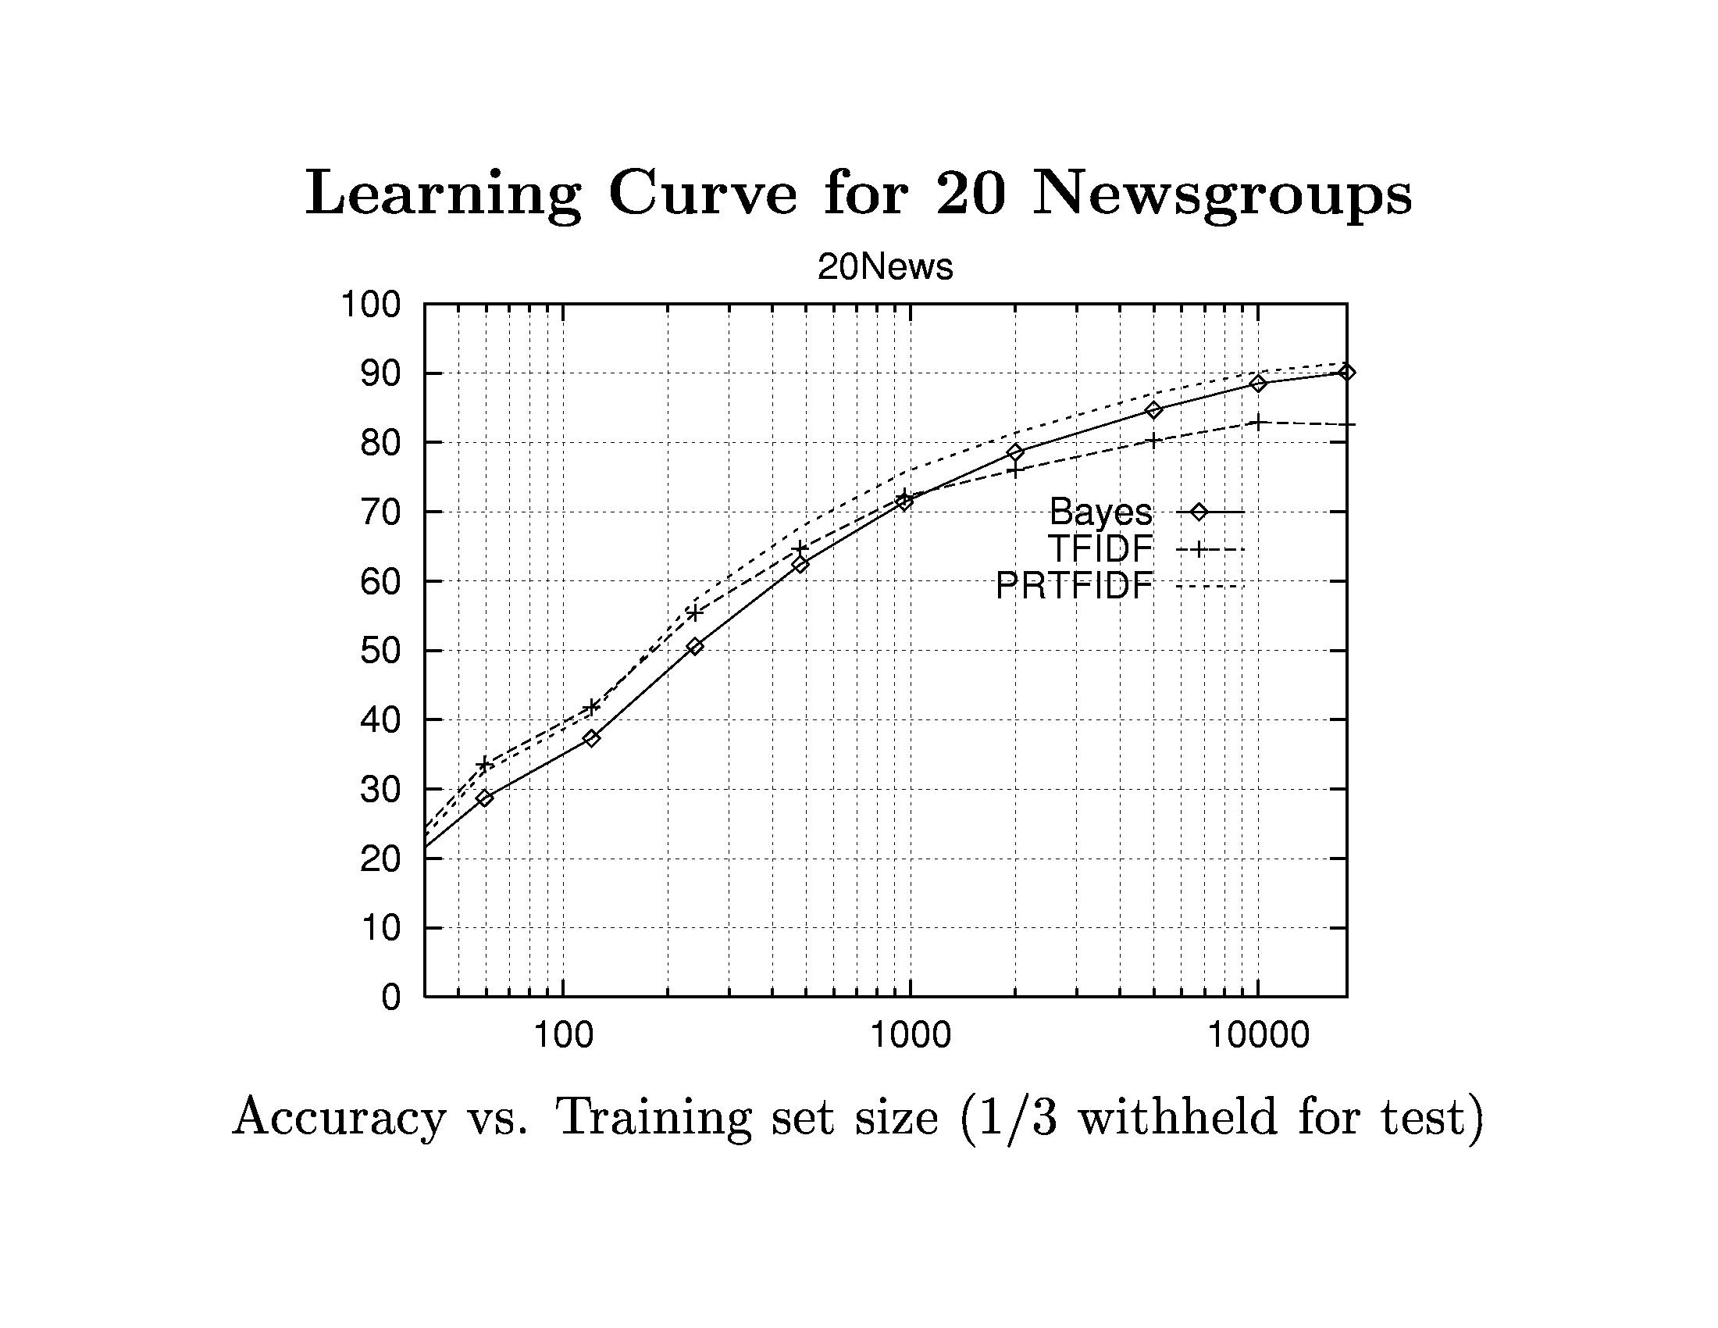
Bayesian Learning

Slide 36
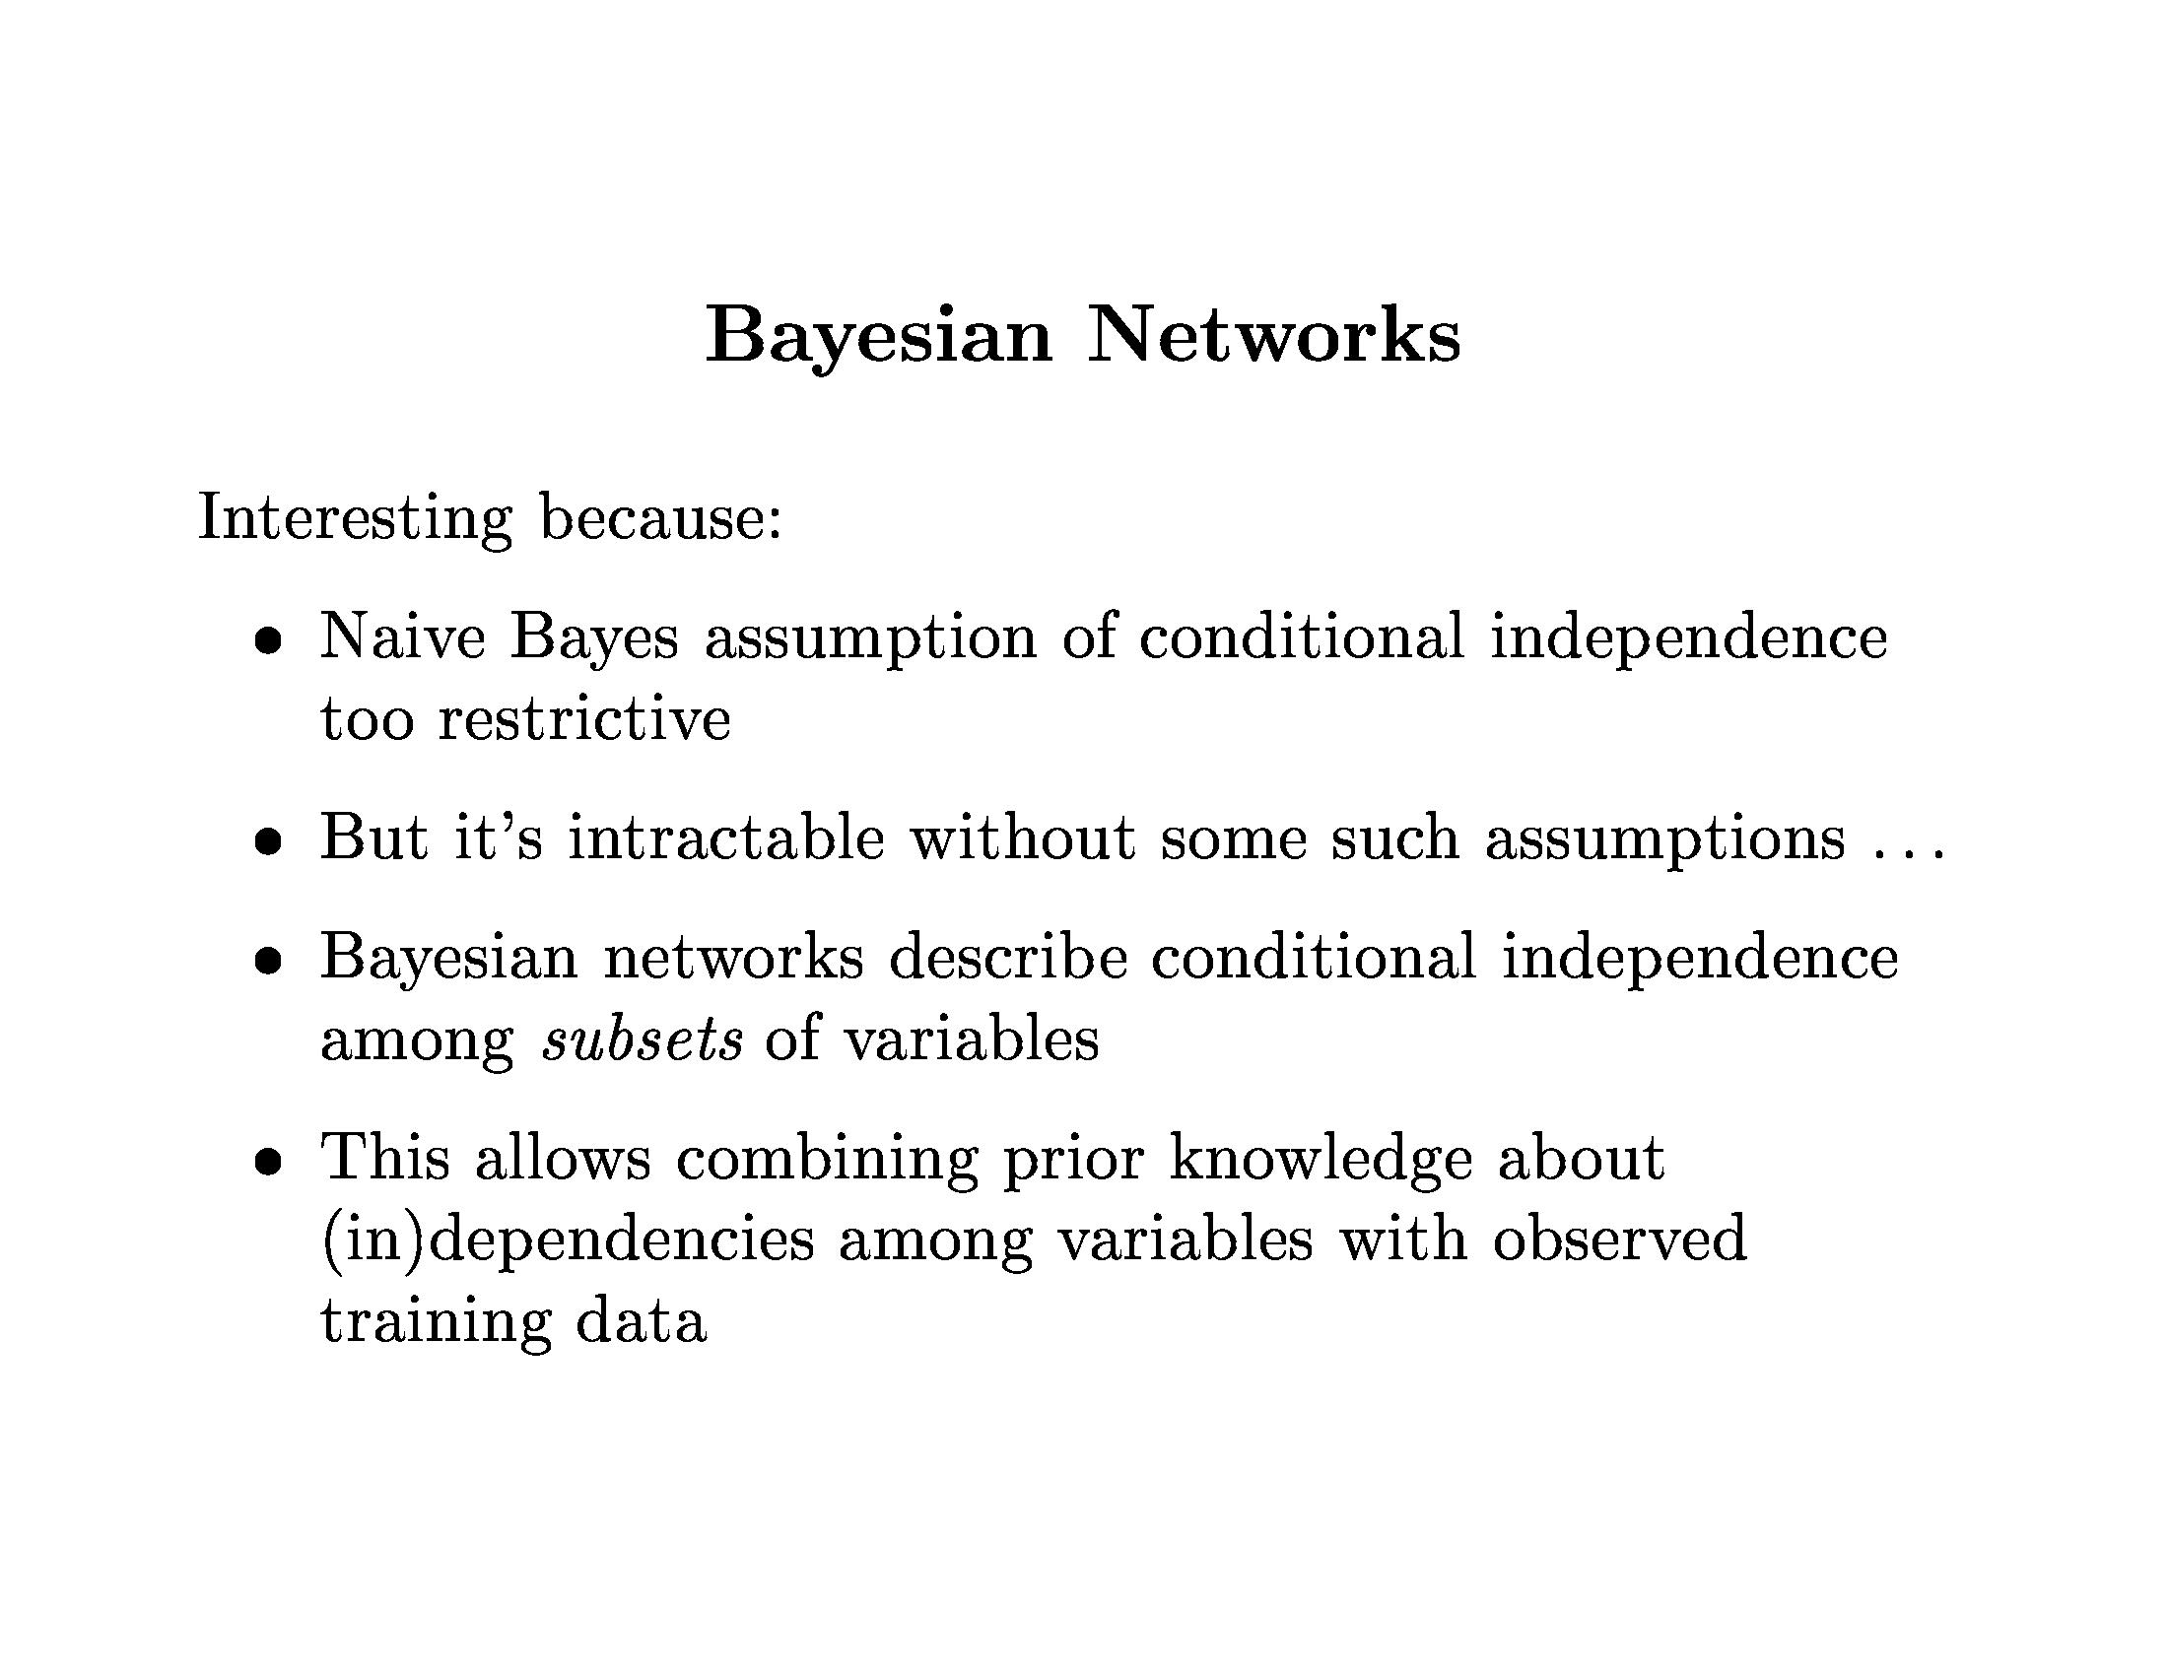
Bayesian Learning

Slide 37
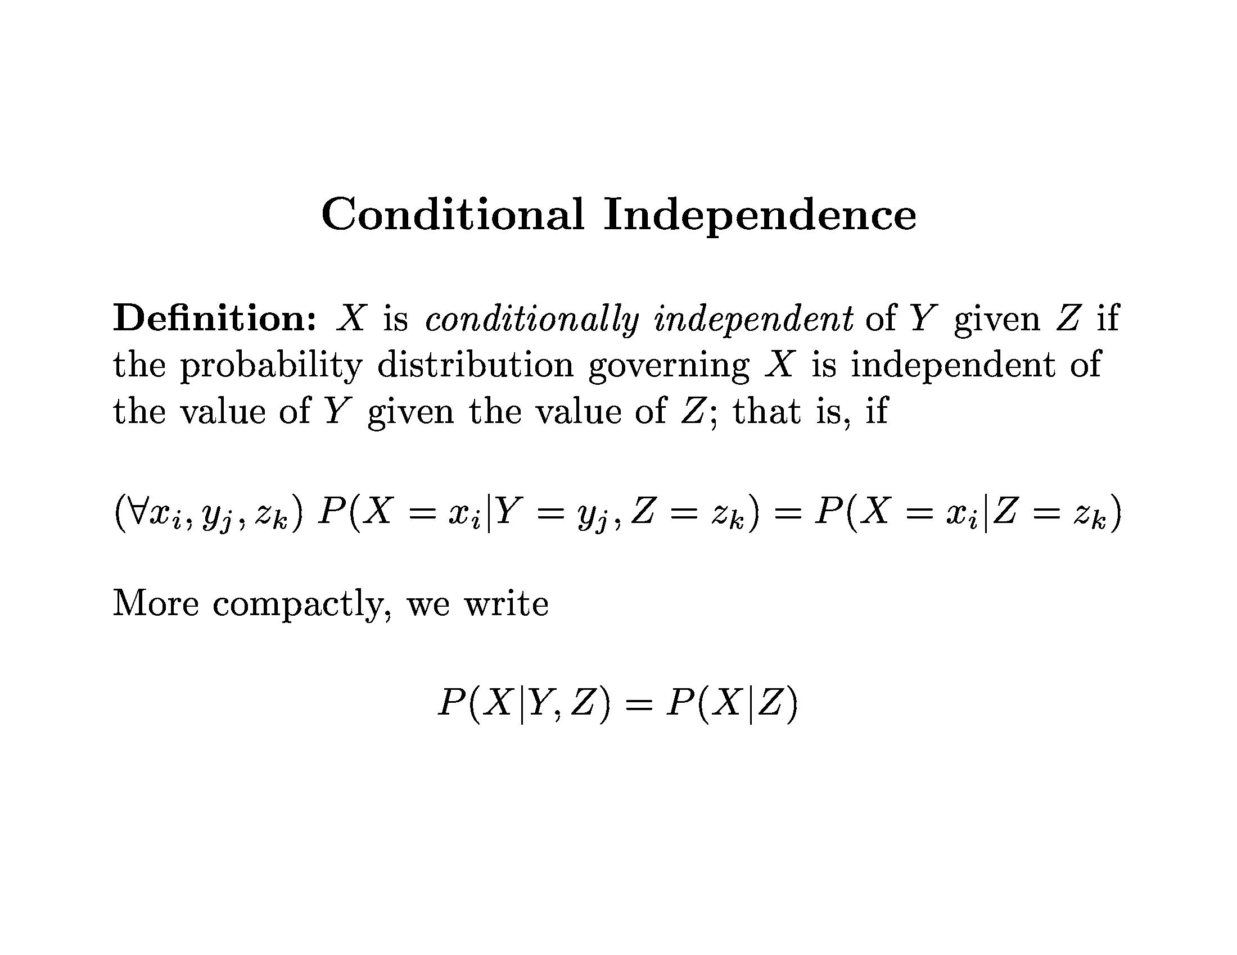
Bayesian Learning

Slide 38
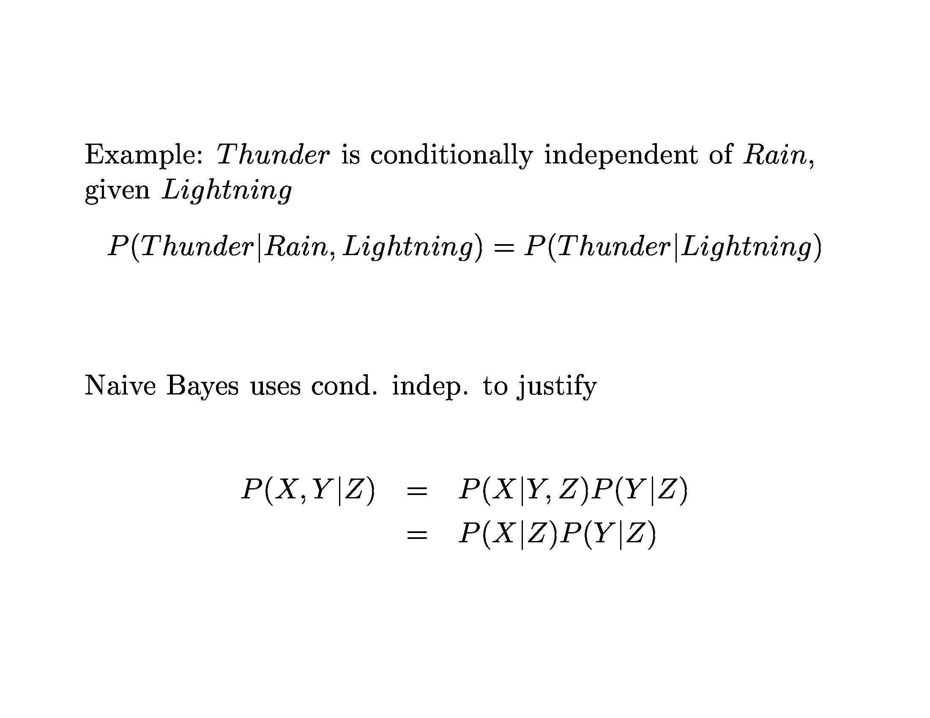
Bayesian Learning

Slide 39
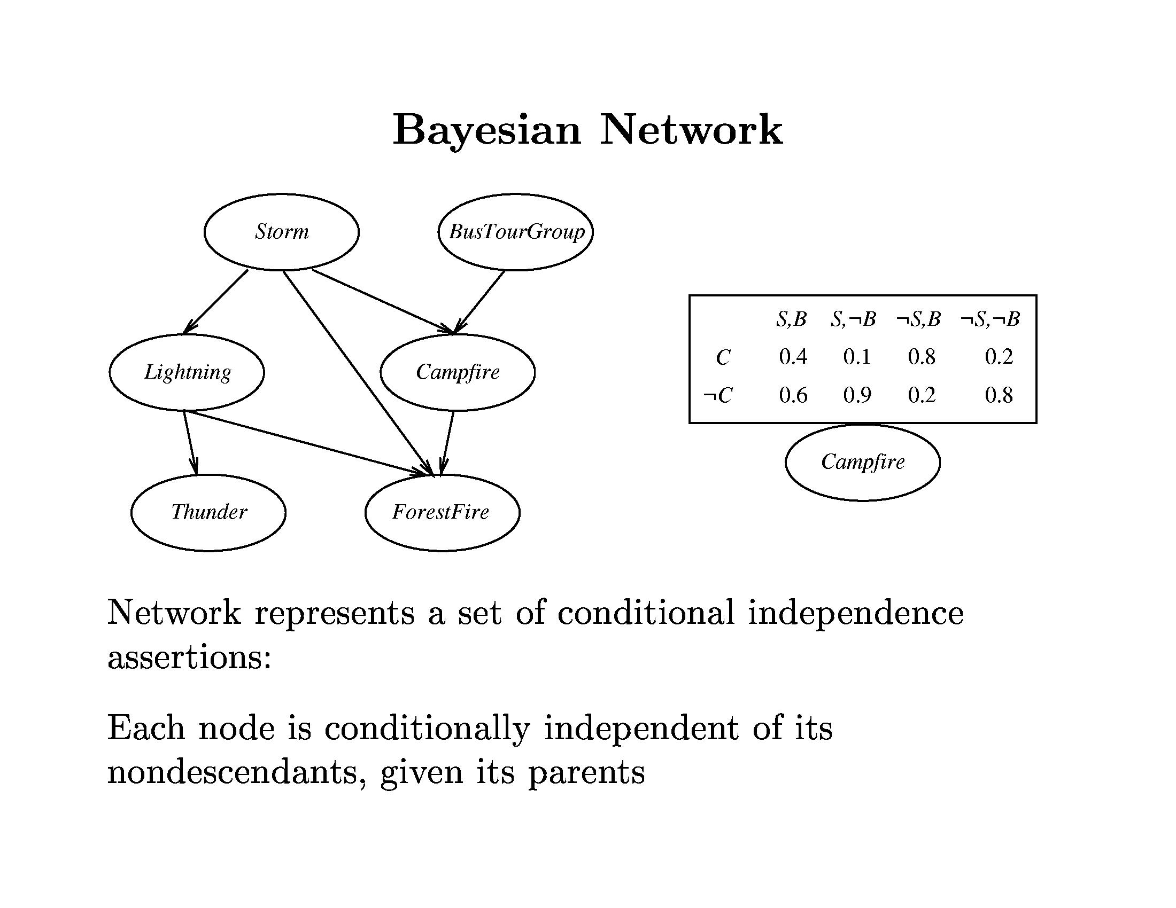
Bayesian Learning

Slide 40
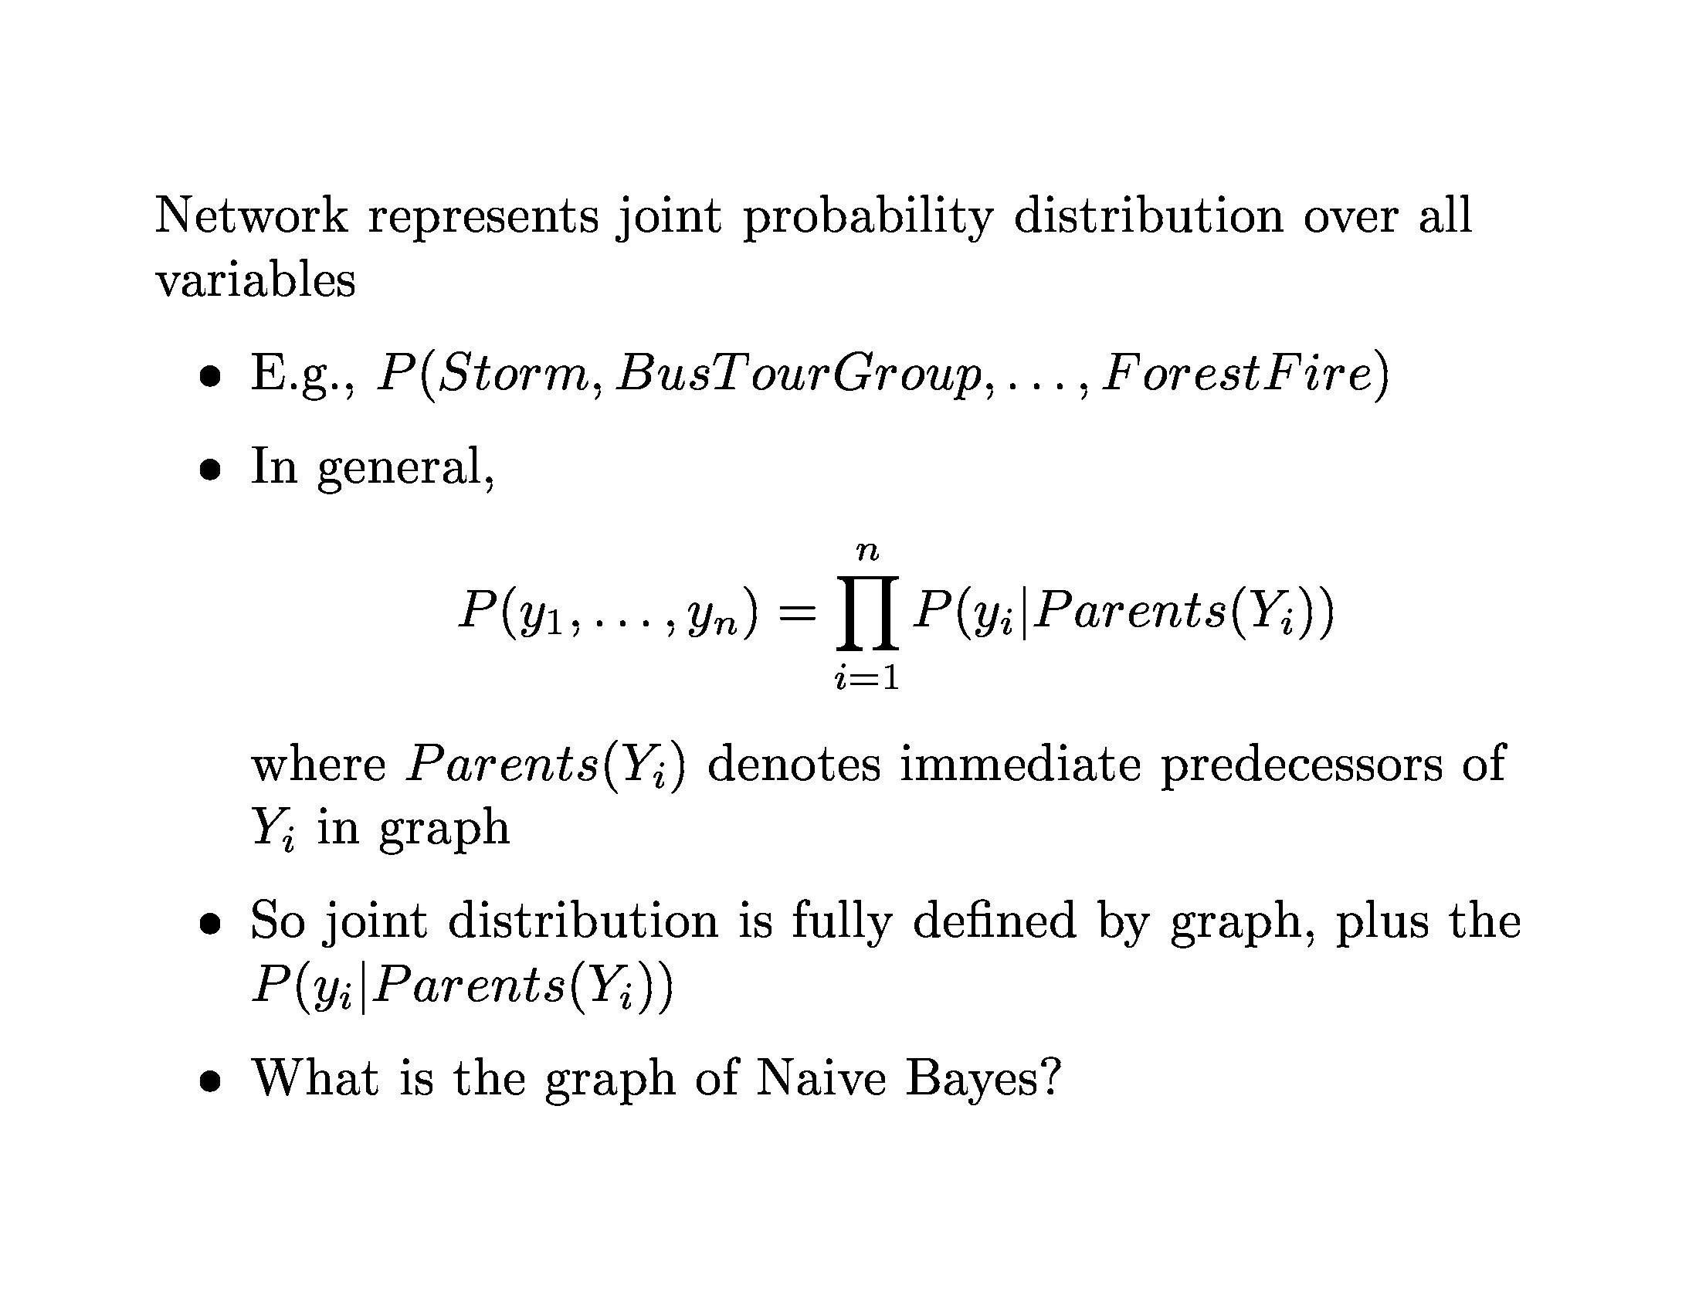
Bayesian Learning

Slide 41
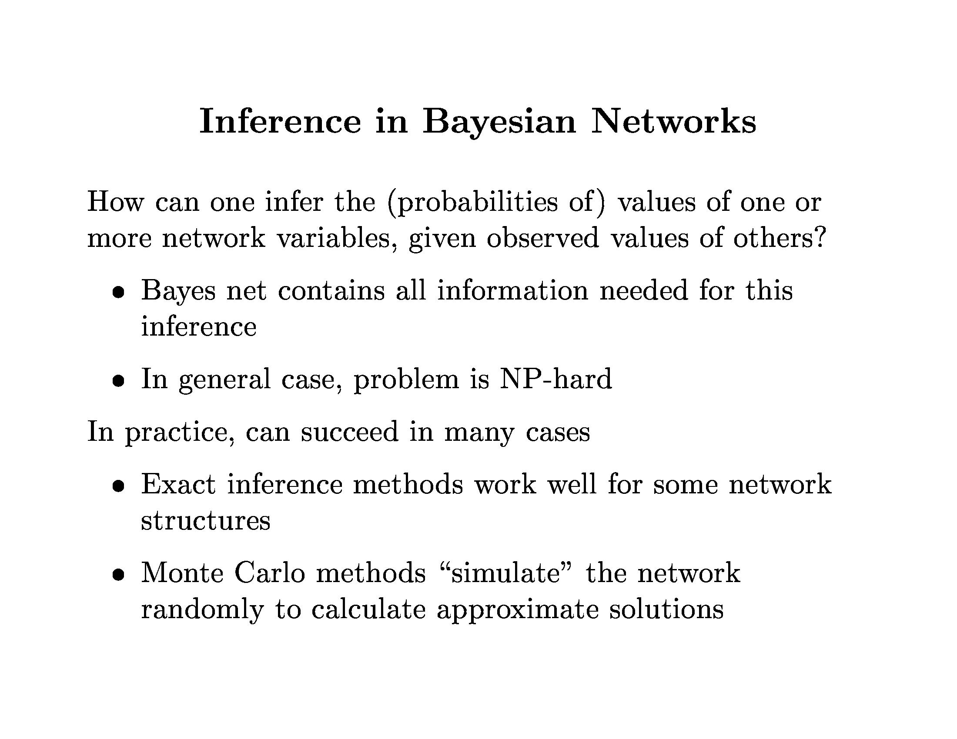
Bayesian Learning

Slide 42
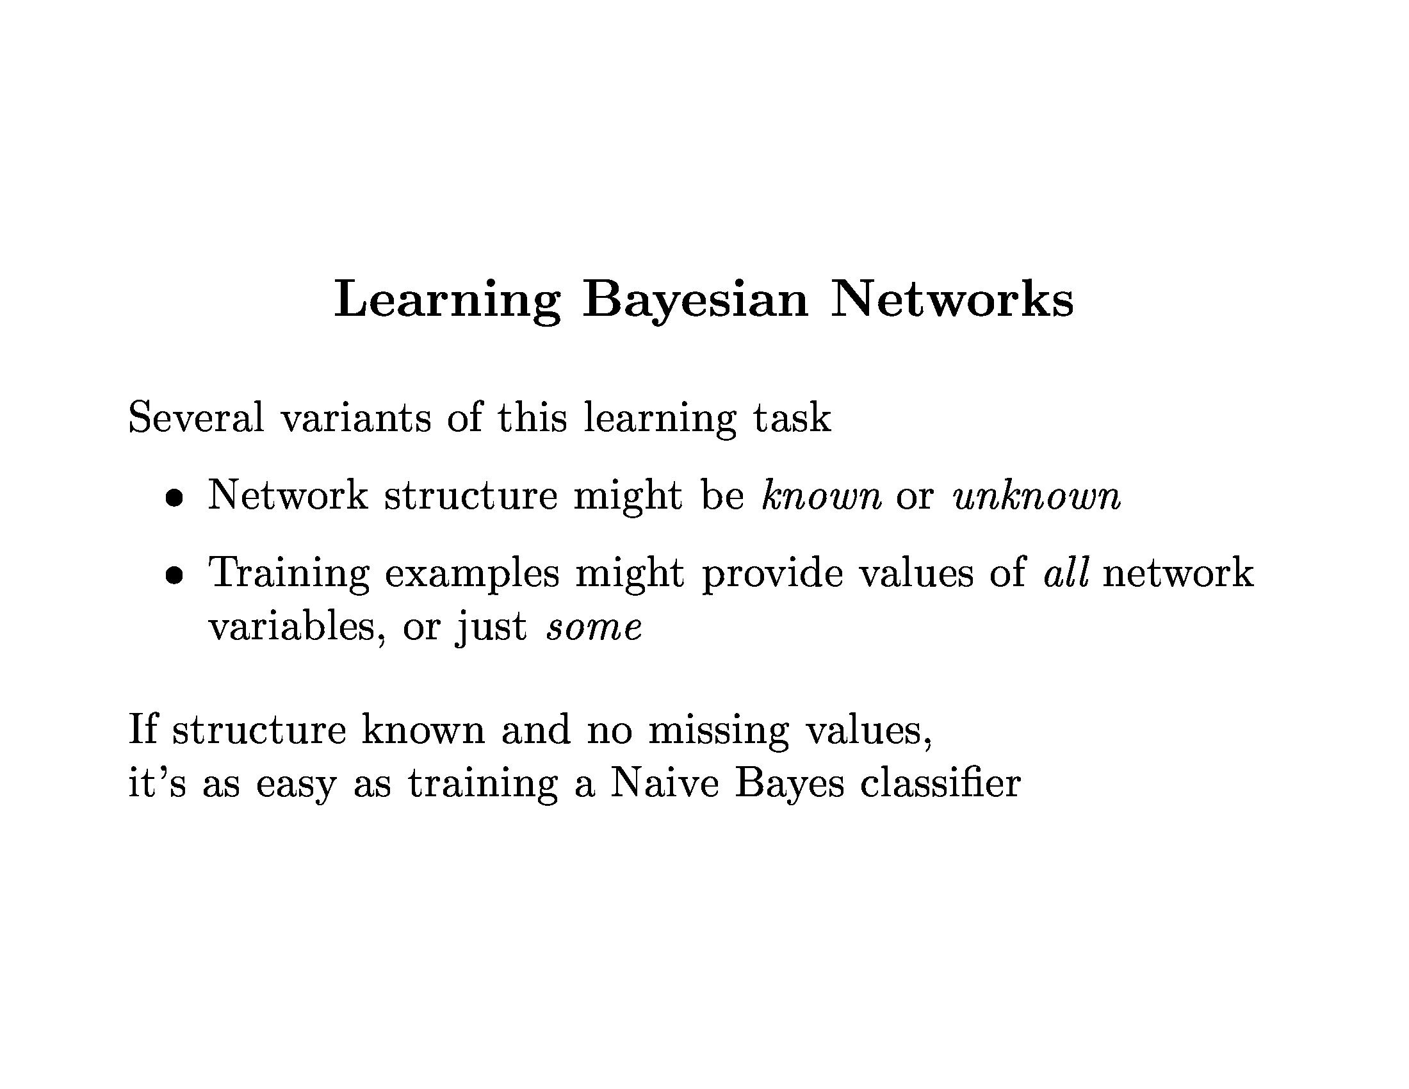
Bayesian Learning

Slide 43
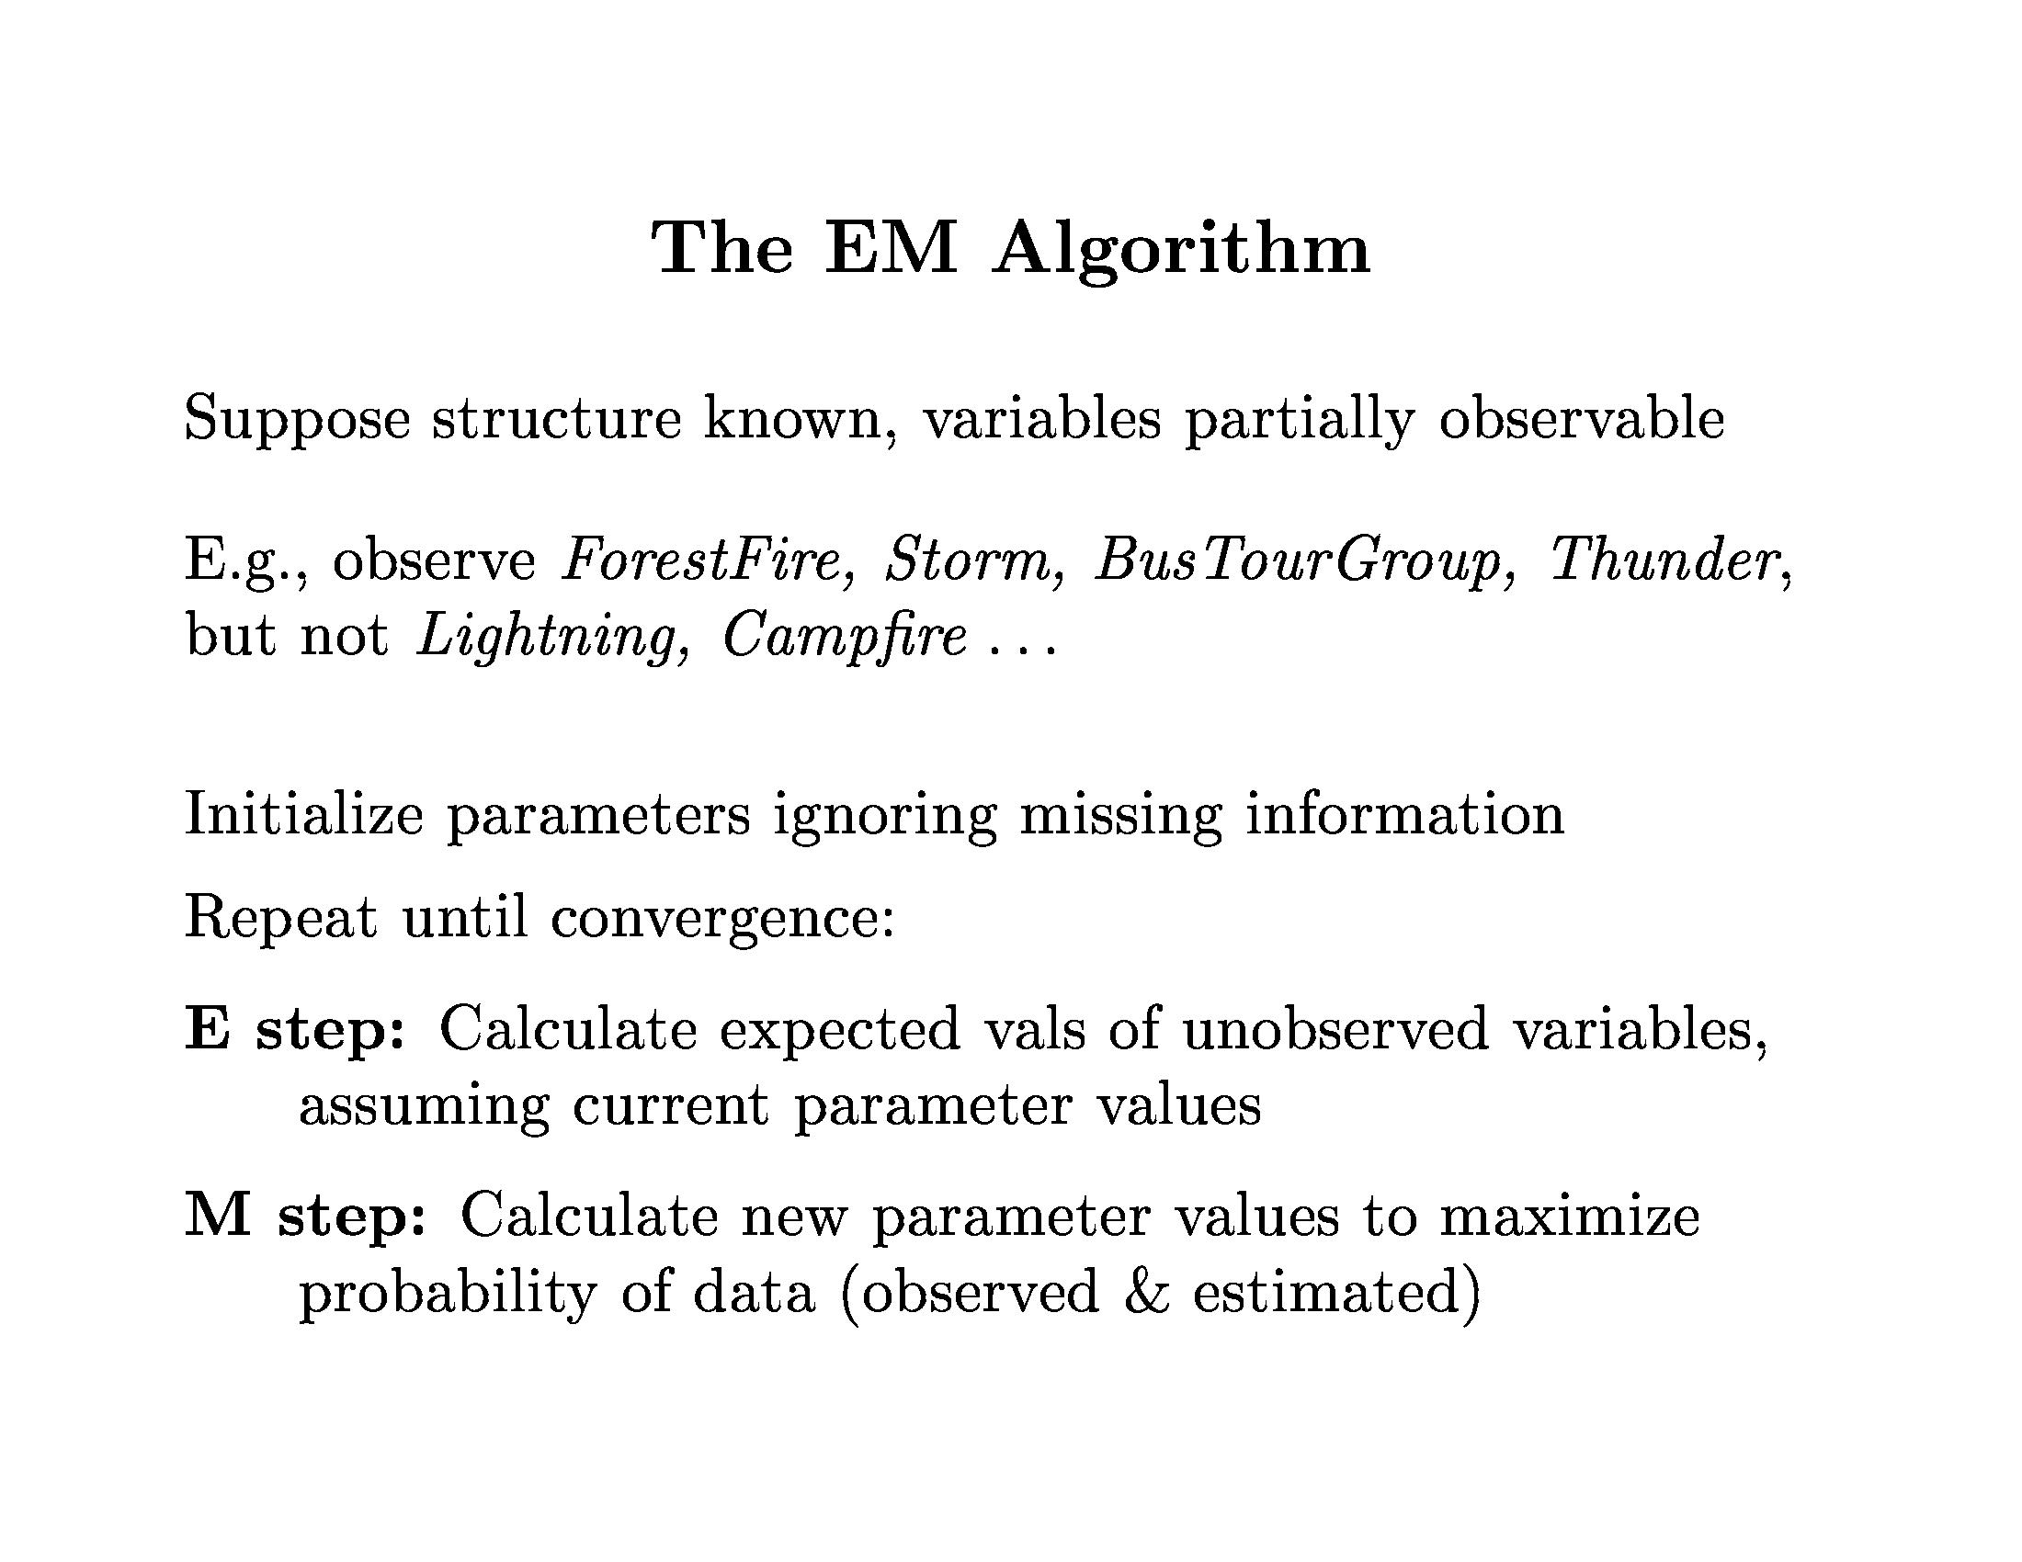
Bayesian Learning

Slide 44
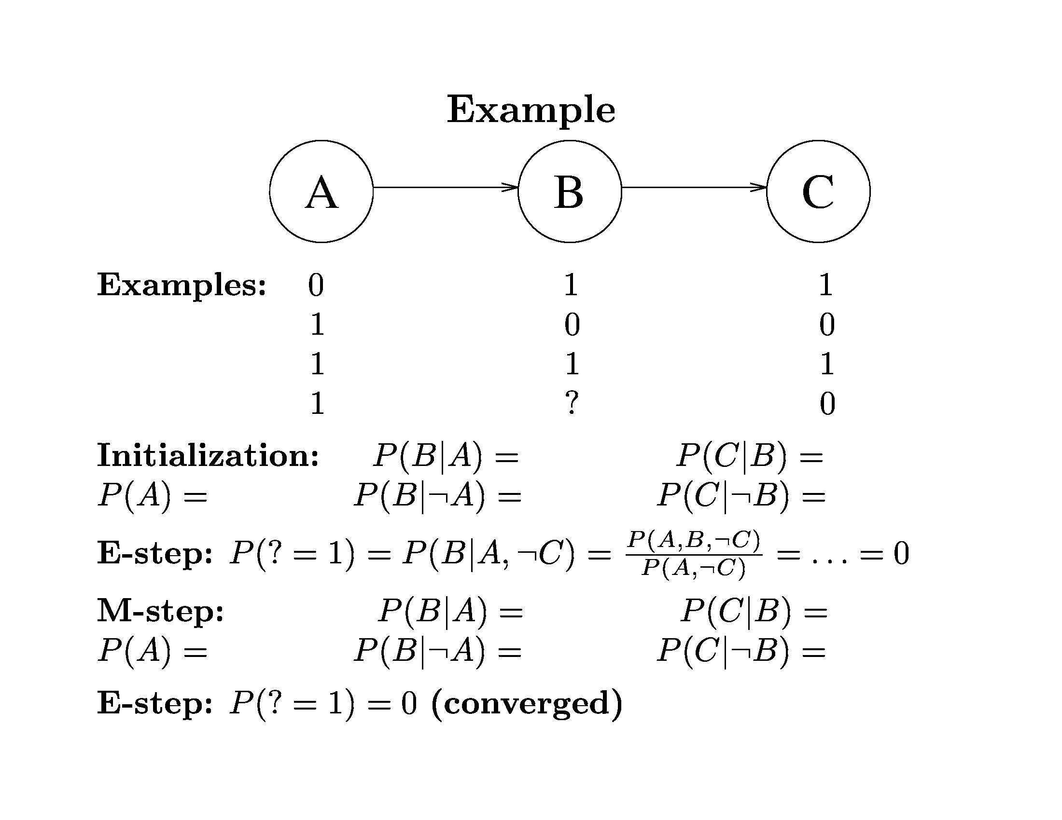
Bayesian Learning

Slide 45
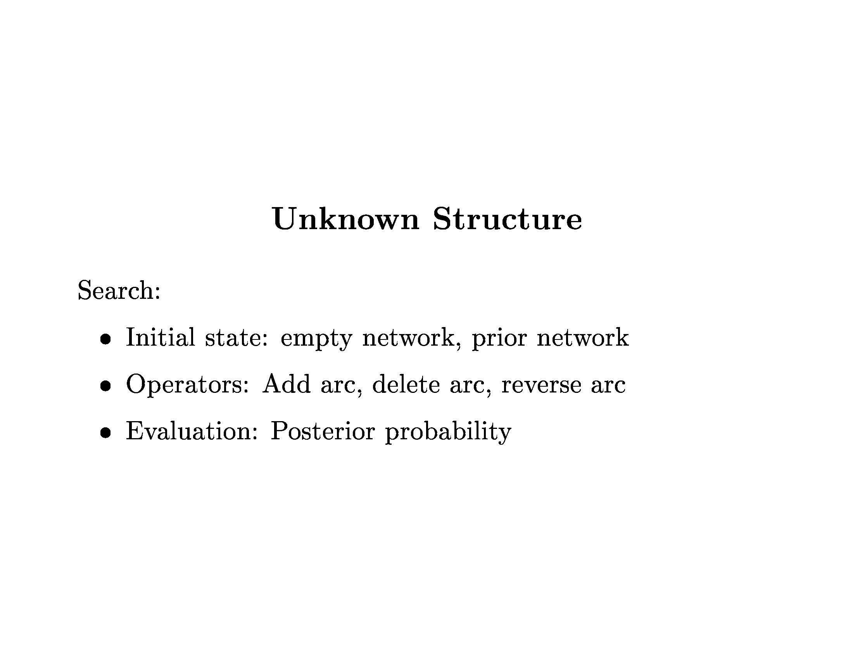
Bayesian Learning

Slide 46
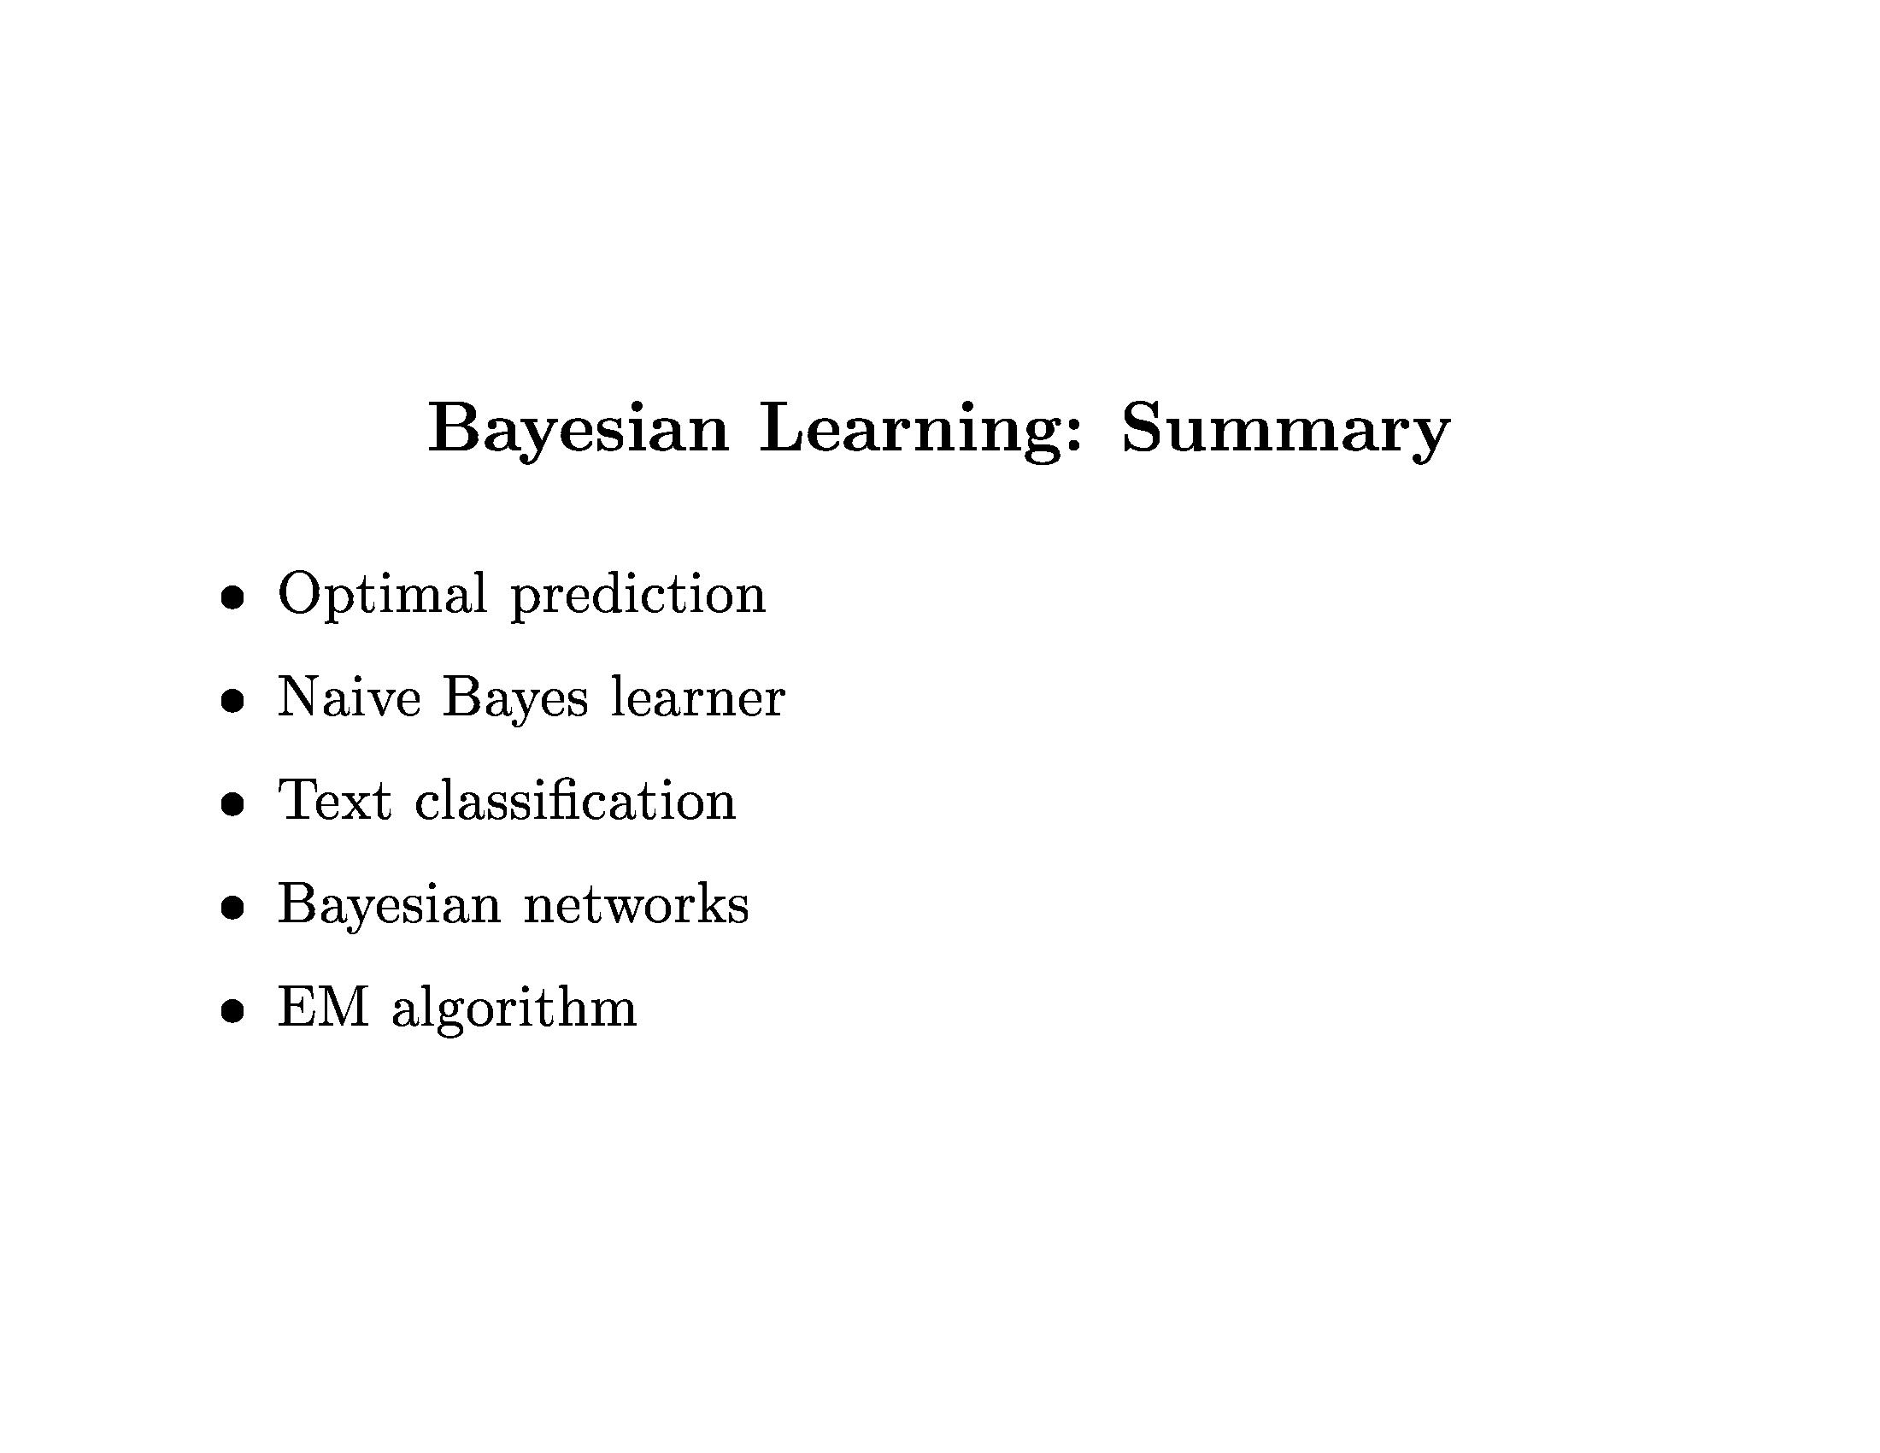
Bayesian Learning

Slide 47
Decision Trees
Exercise: Bayesian Learning in Python

